Slide 1
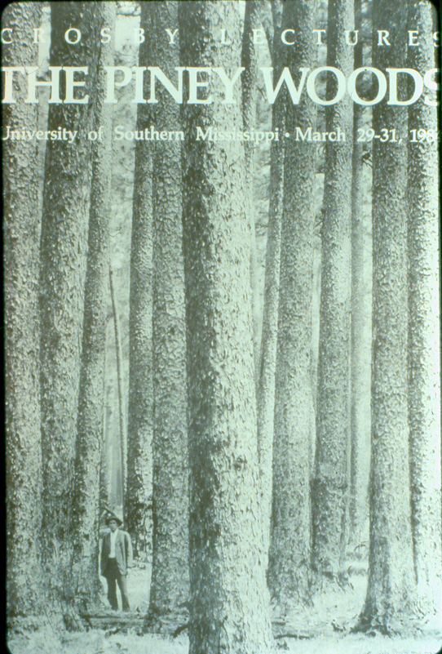
BRIEF HISTORY OF LONGLEAF PINE IN THE FLORIDA PARISHES OF LOUISIANA
Southeast Louisiana Longleaf Pine Field Day
Restoring and Managing Longleaf Pine on Private Lands
24 May 2012

Slide 2
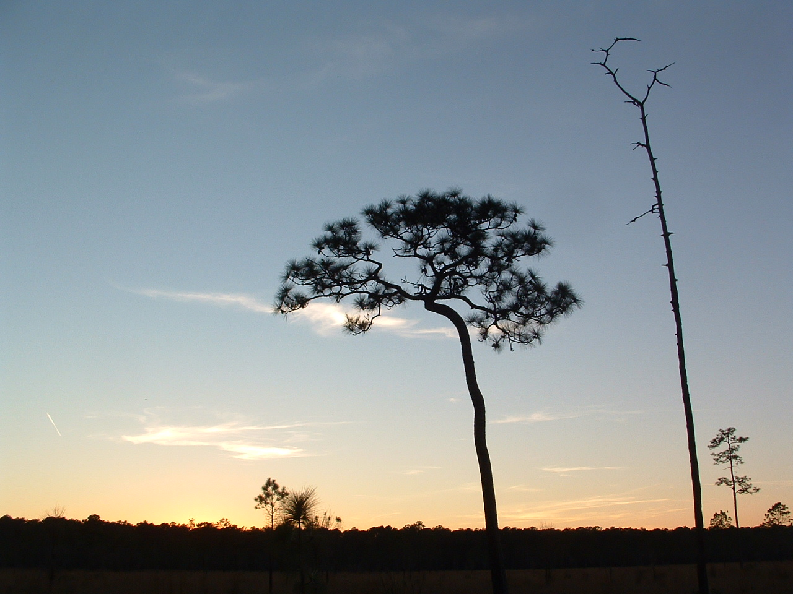
WHY SO MUCH FUSS ABOUT LONGLEAF PINE?
Some Reasons:
* The most expansive historic forest type of the deep south. Originally ~ 70-90 million acres.
* Most cleared between 1880 and 1930.
* Less than 5% remains in natural stands across its range.
* Very high numbers of plants and wildlife that are only found in this forest type. Many of these are rare today.
* One of the “world’s greatest timber trees” that produces the highest quality lumber of any southern pine.

Slide 3
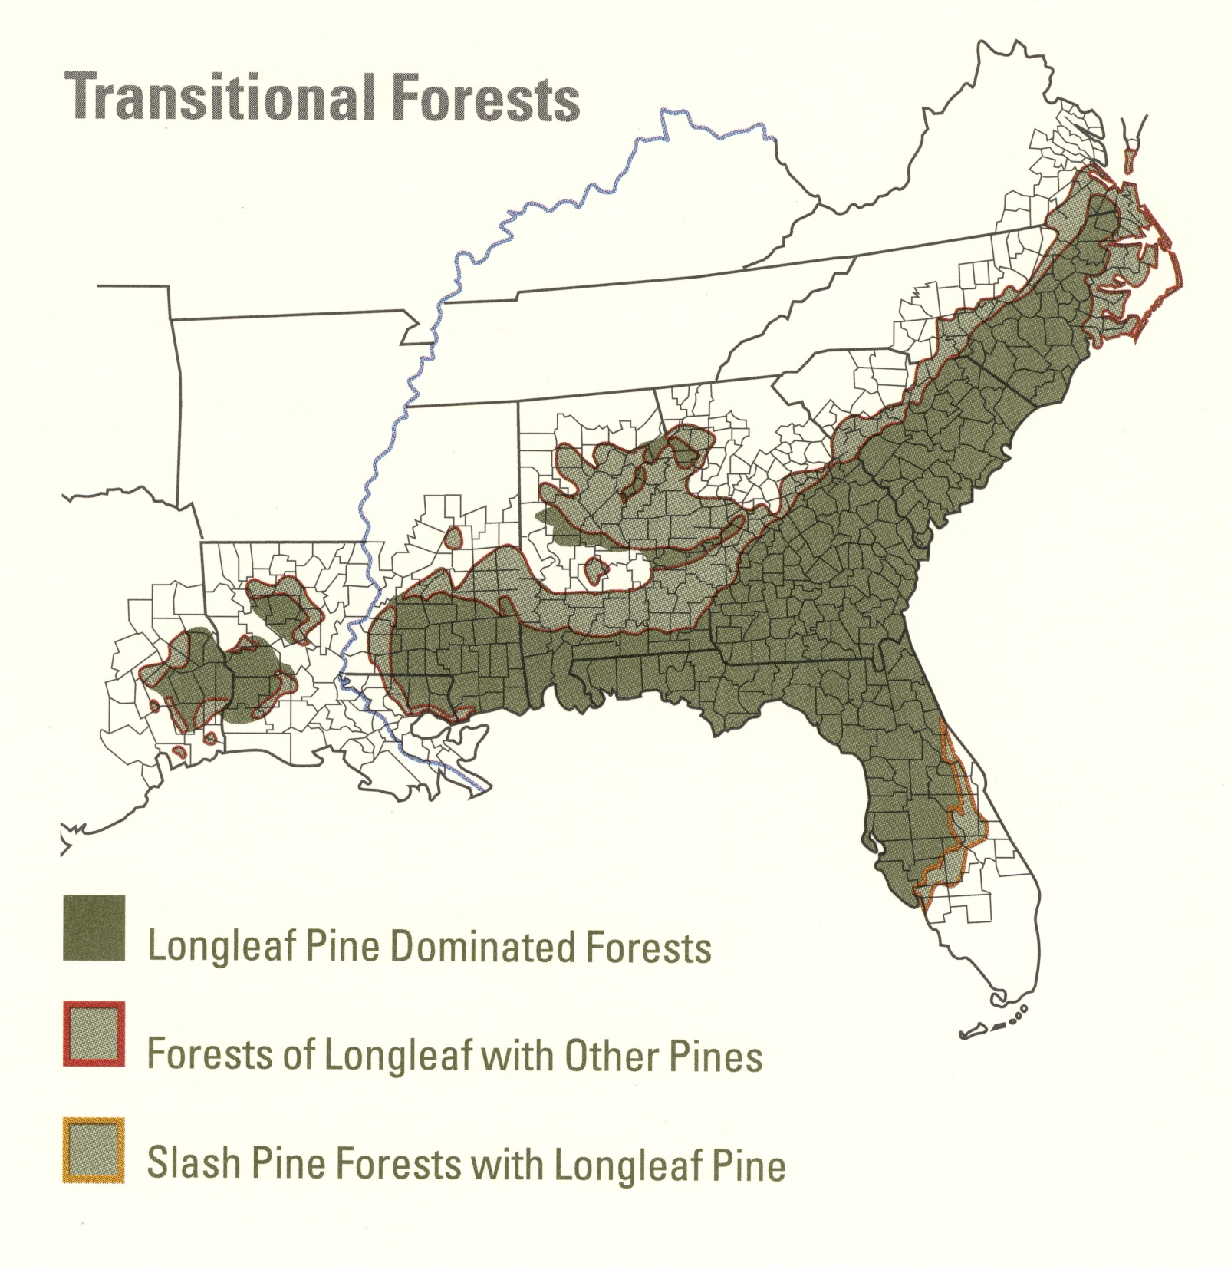
Longleaf Pine Range
[Map compiled by Julie Moore, “Managing the Forest and the Trees”]

Slide 4
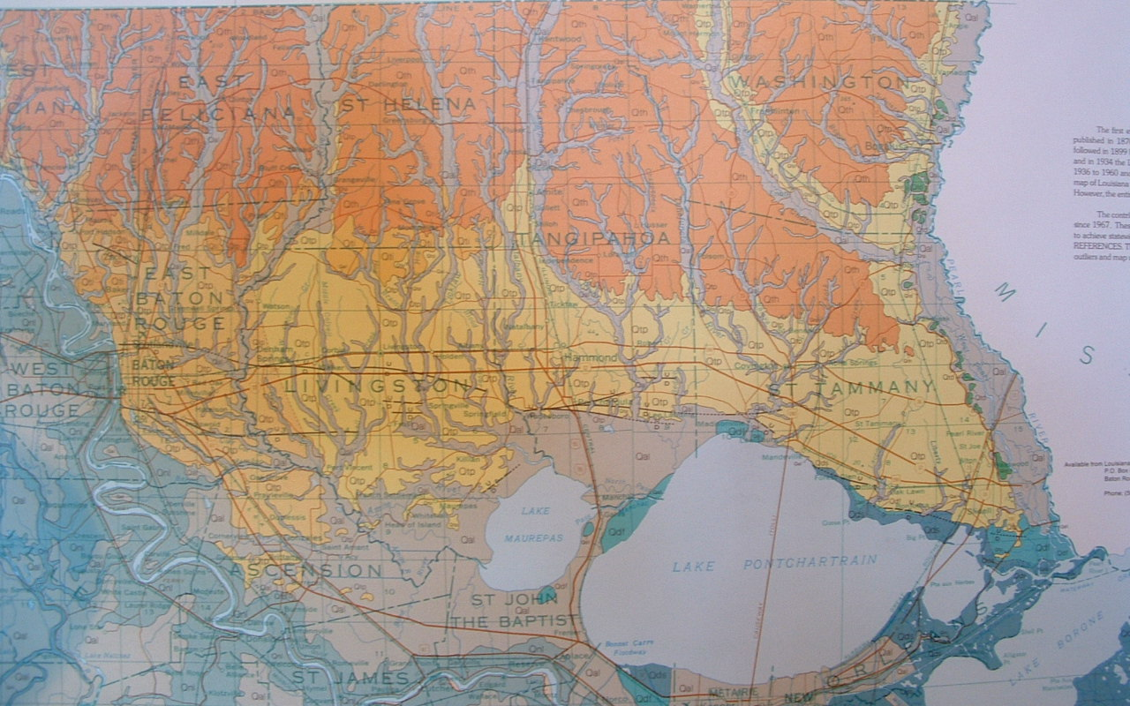
Kentwood
Clinton
LONGLEAF PINE HILLS
Bogalusa
Amite
Pride
Folsom
Western Edge of Range
Hammond
LONGLEAF PINE FLATS
In 1850:
~ 1.5 Million Acres Total
In Central and Eastern Florida Parishes

Slide 5
Kentwood
Clinton
Franklinton
Greensburg
Bogalusa
Amite
Pride
Folsom
Hammond
Covington
Only ~ 20,000 - 30,000 Acres
Of Natural Stands Remain
(1 – 2% of original)

Slide 6
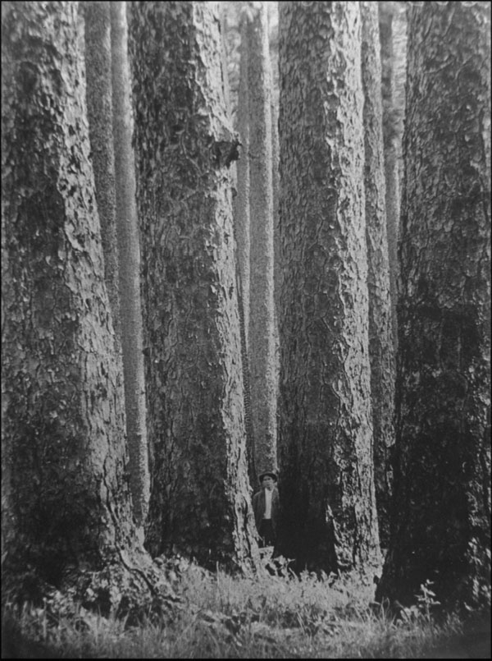
What Happened?
Beginning in late 1700’s

Slide 7
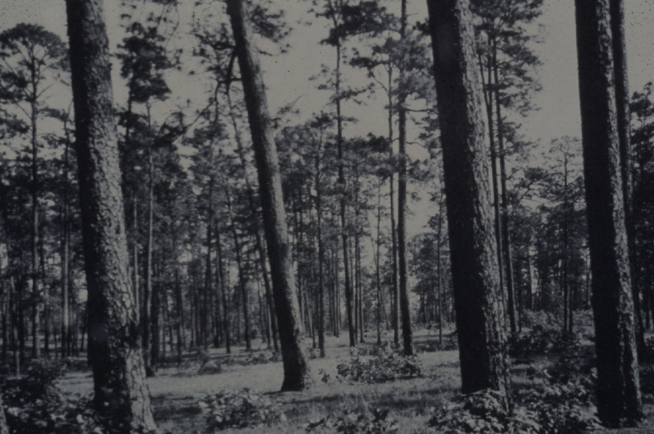
Virgin Longleaf Pine
Essentially pure longleaf pine; scattered hardwoods (e.g., post oak, blackjack oak)
Stretched for mile after mile, broken only by hardwood-lined bluffs & stream bottoms
Much stand patchiness (dense to open) and age variation across stands
Very diverse ground cover – grasses & wildflowers
- Abundance of wild game (e.g., deer, bear)

Slide 8
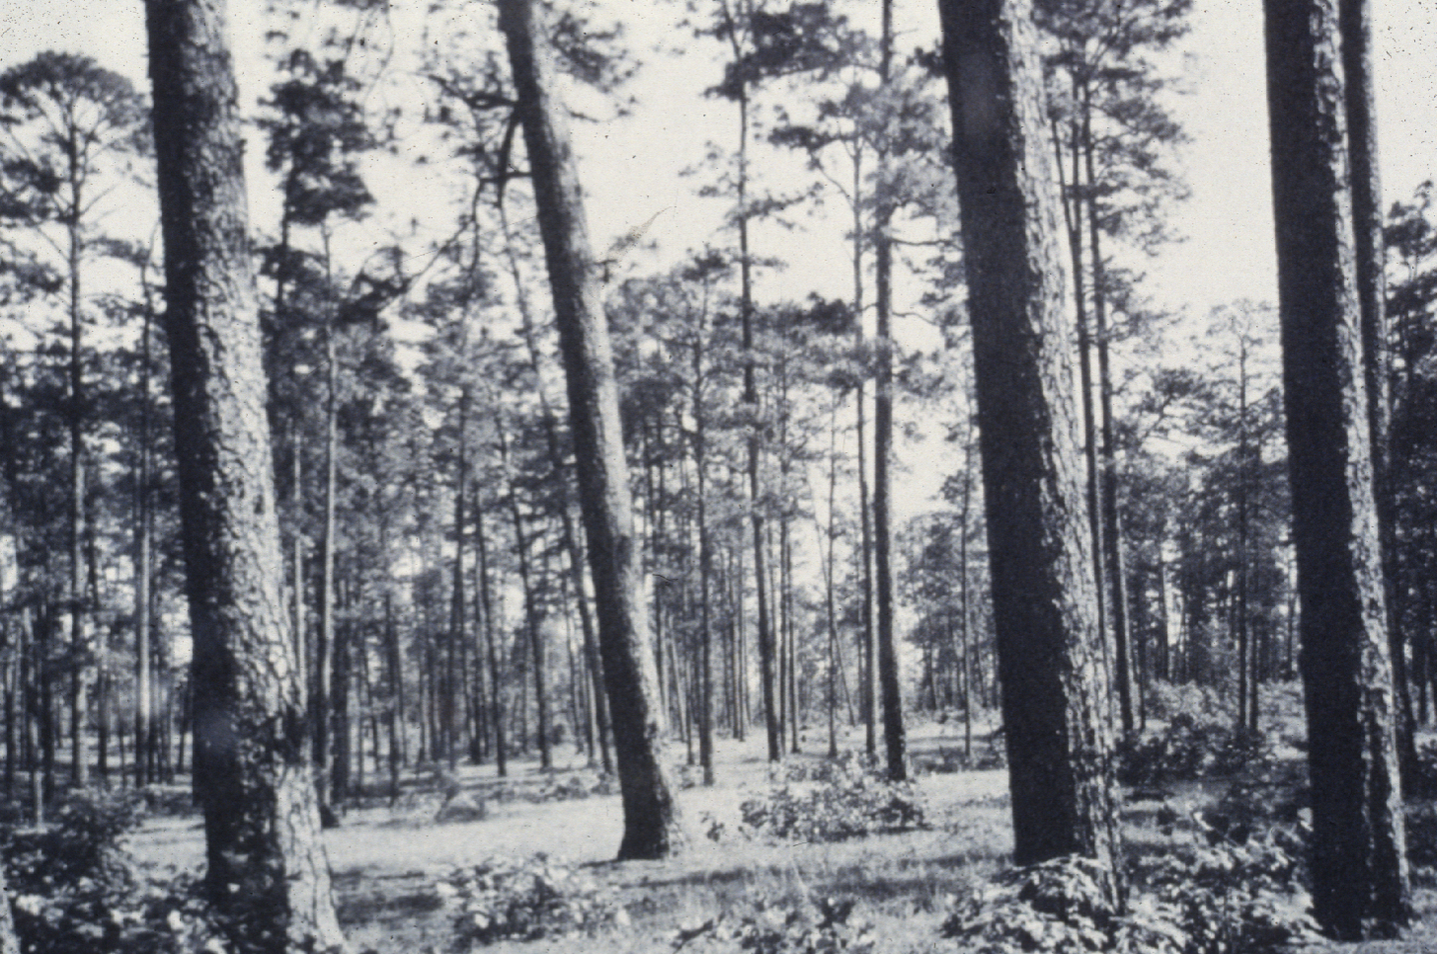

Slide 9
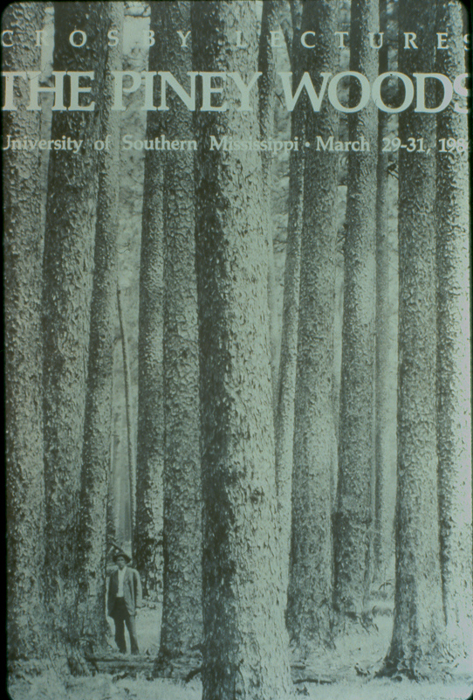
Longleaf Trees in Virgin Forest:
  Up to ~ 40 inches in diameter at breast height
  Up to ~ 120 feet tall
  200 years common; A few > 400 years old
  Over 30,000 Board Feet per acre not uncommon in this area

Slide 10
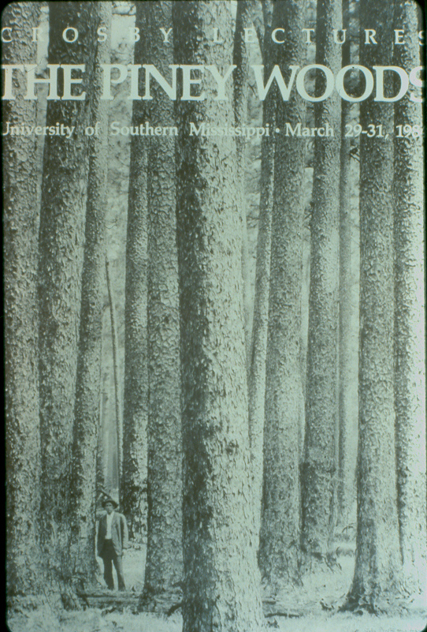

Slide 12
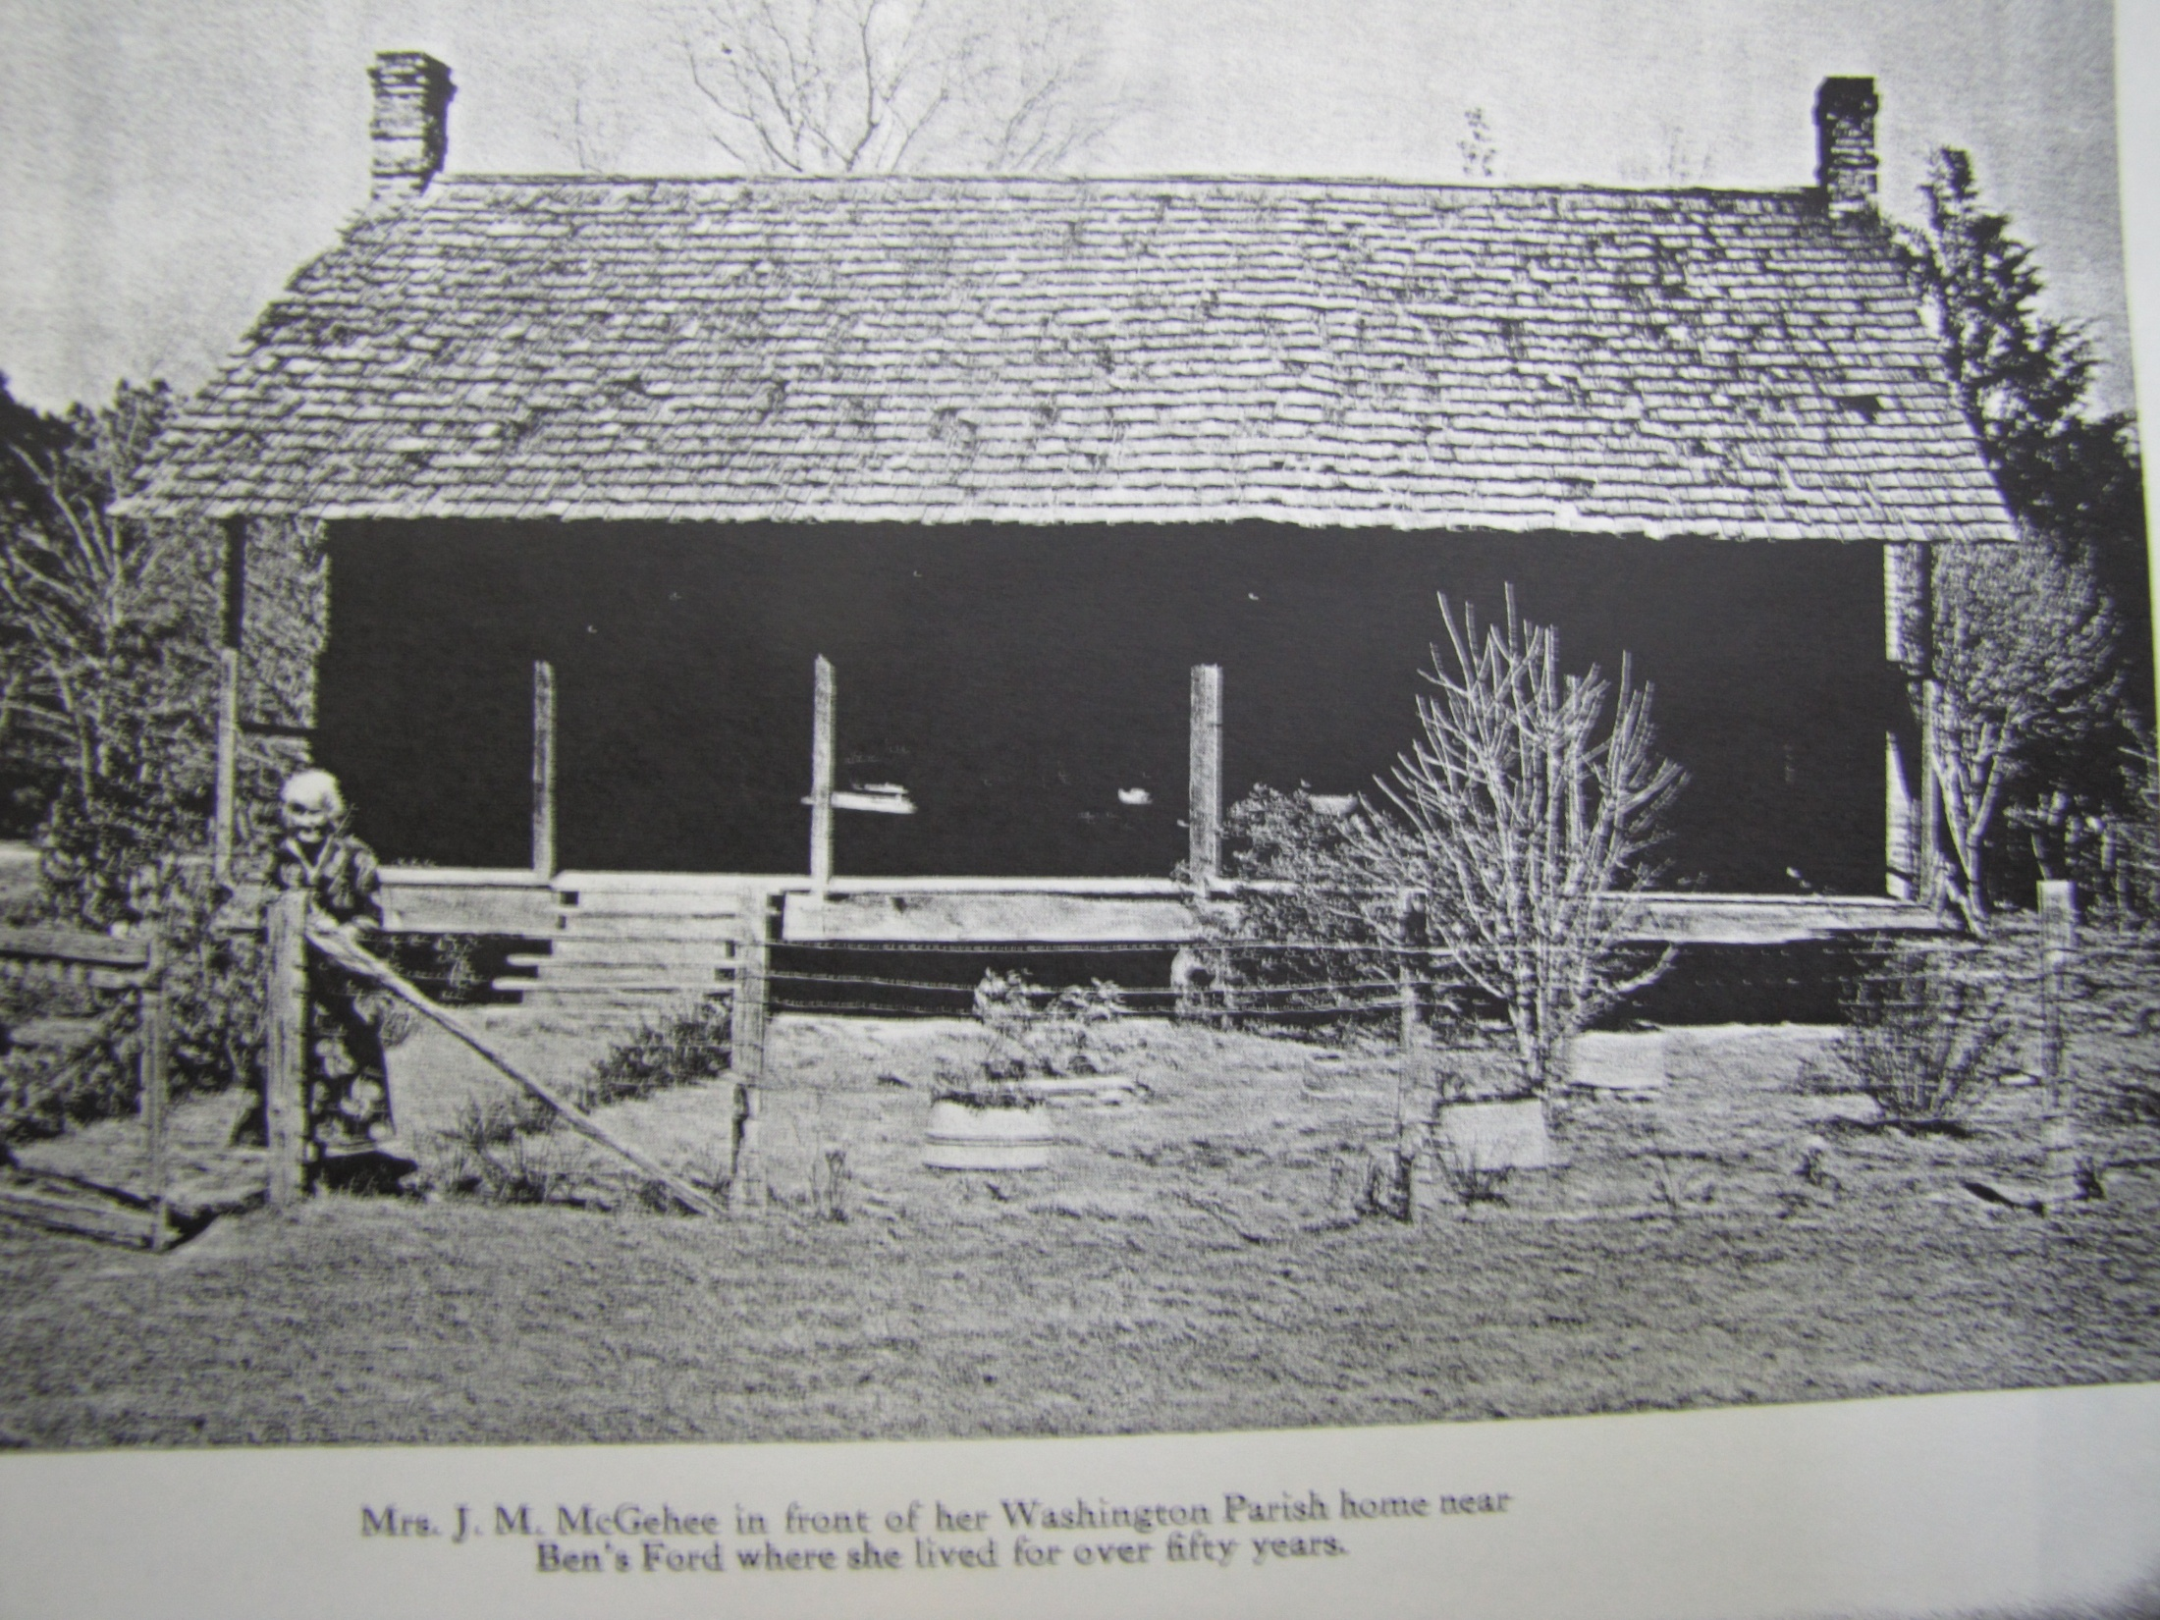
Earliest Settlers in late 1700’s
Photo from “Bogalusa Story” by C.W. Goodyear, 1950

Slide 13
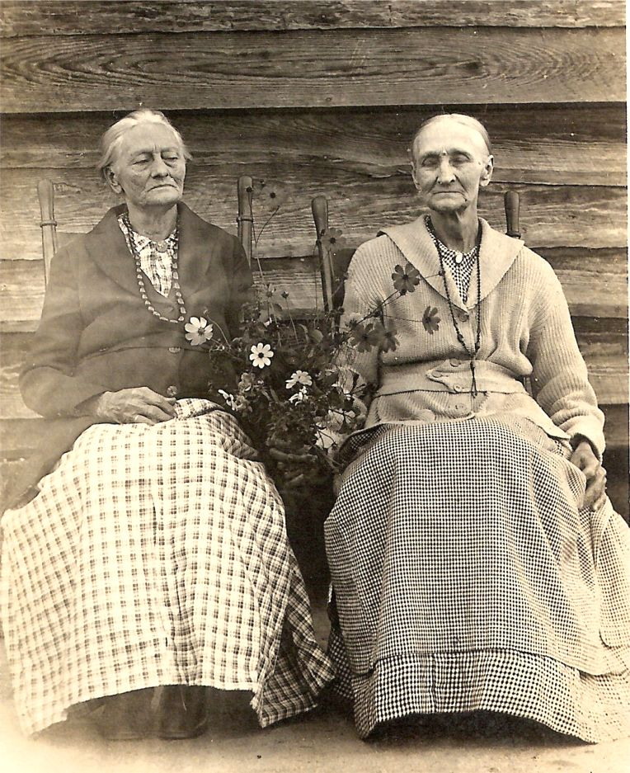
“They desired an open, poor, pine country, which forbade a numerous population.”
“Here they grew sufficient corn for bread and a few of the coarser vegetables, and in blissful ignorance enjoyed life after the manner they loved. The country gave character to the people: both were wild and poor. . . William H. Sparks, Ca. 1850

Slide 14
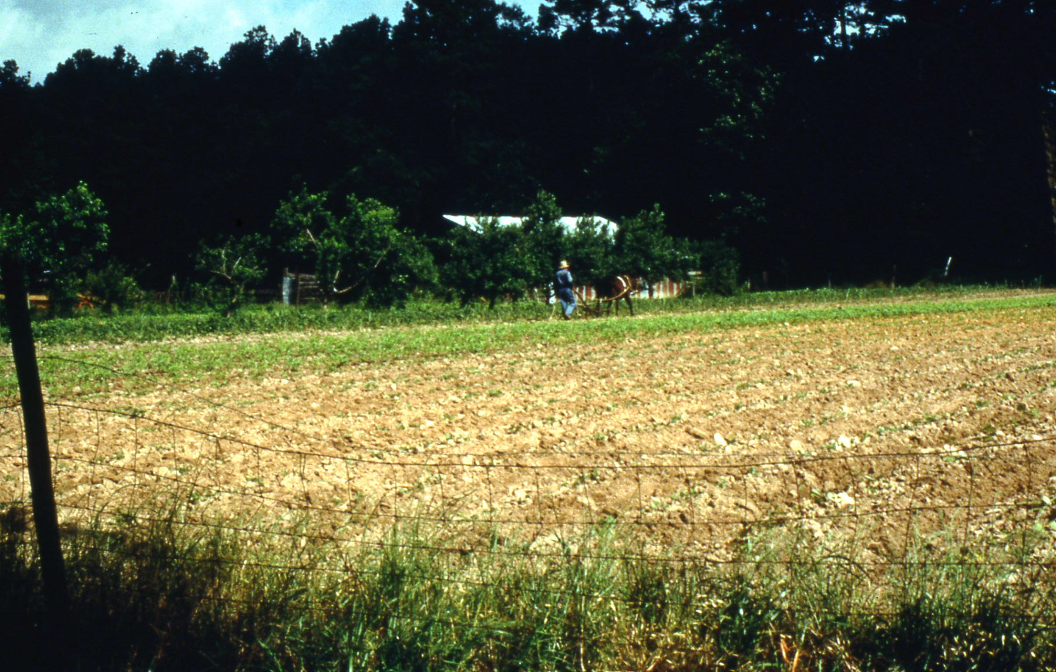
CORN
SWEET POTATOES
BEANS, PEAS
PEANUTS
“UPLAND RICE”
SUGAR CANE
Common crops of early settlers:

Slide 15
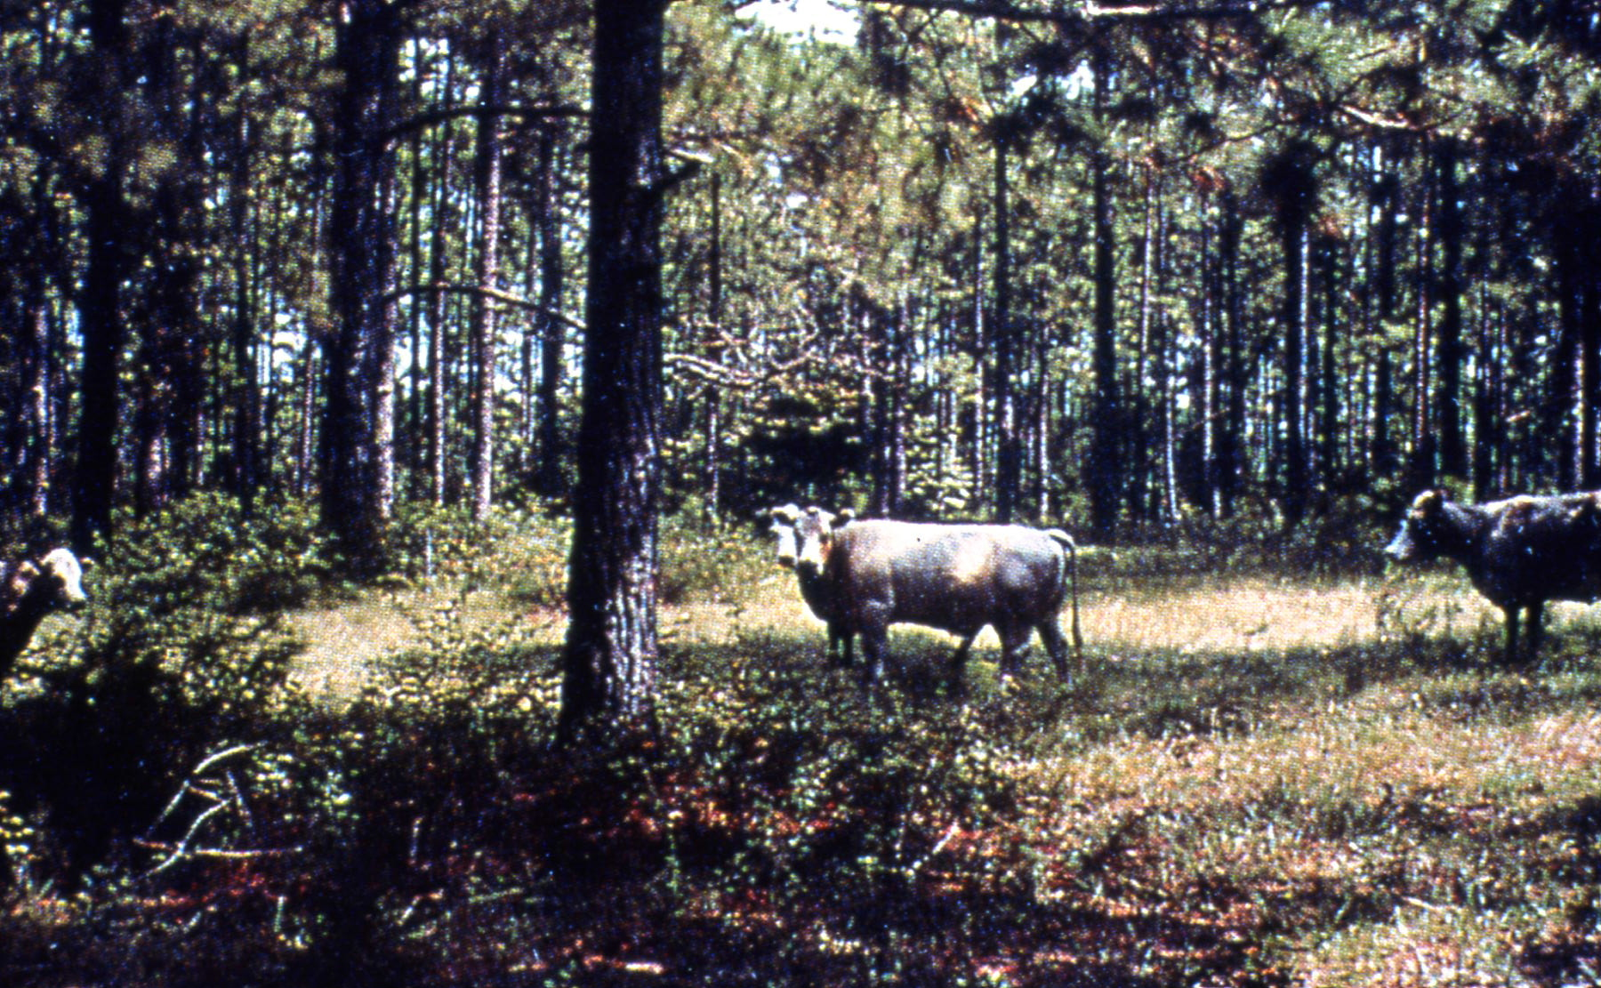
Free-Range Livestock
Depended on the Piney Woods for “Grass and Game”

Slide 16
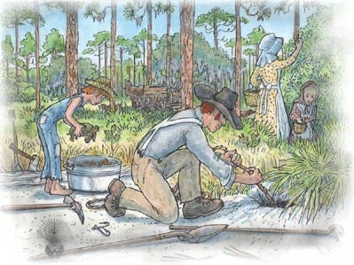
CHOCTAW INDIAN
“Pulling” Gopher Tortoises
Graphic courtesy of the Longleaf Alliance

Slide 17
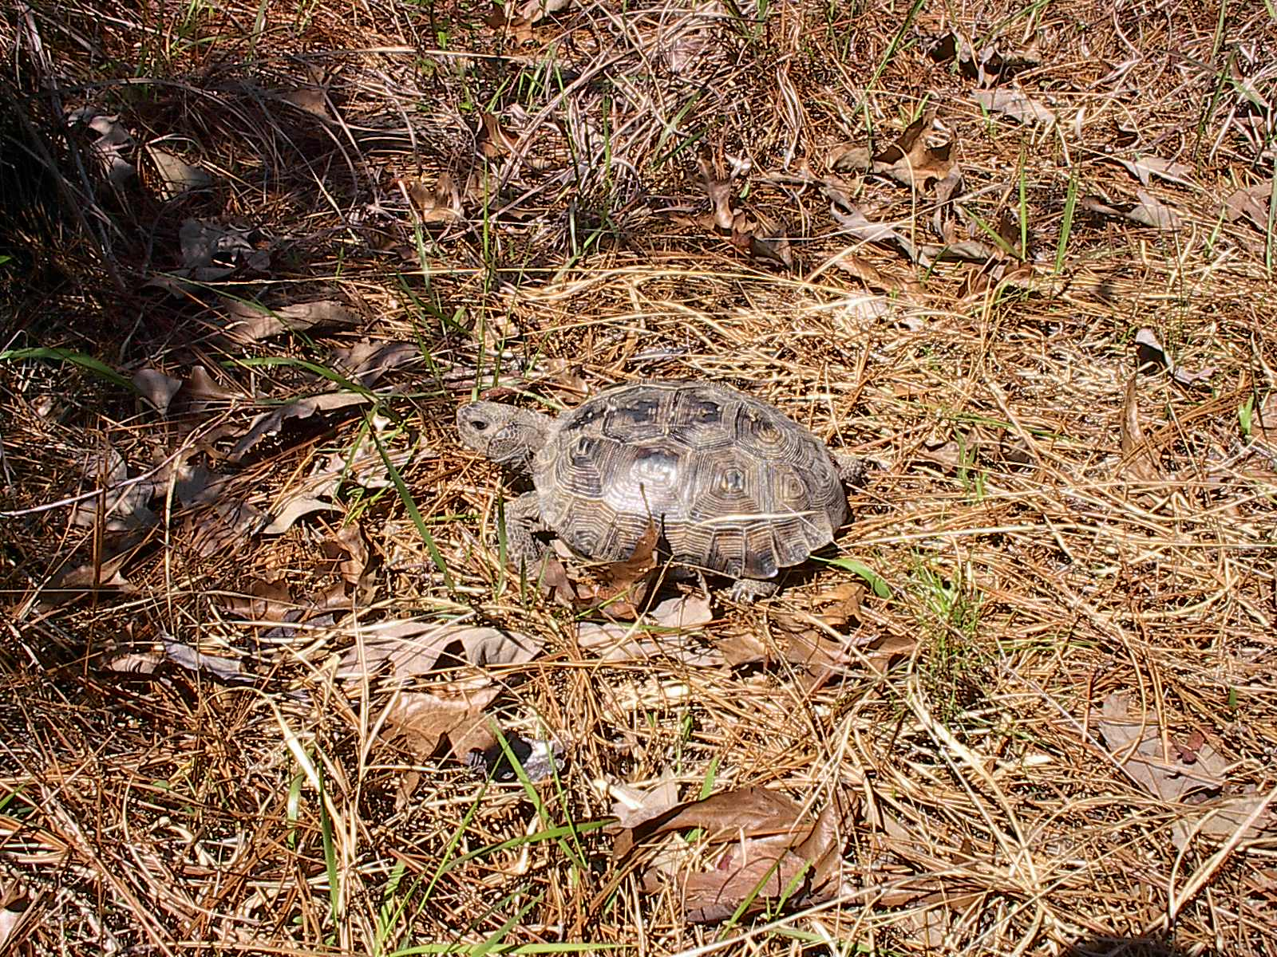
GOPHER TORTOISE

Slide 18
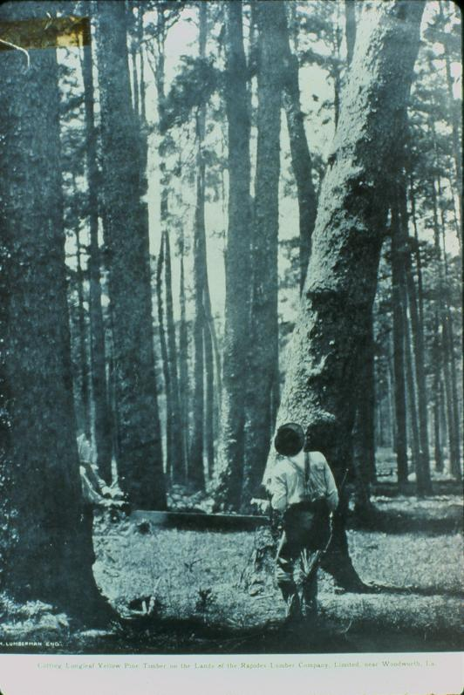
  Early settlers had little impact
  Relatively limited cutting before the Civil War
  Early logging restricted to areas near streams; within a few miles
  Logs taken by oxen- and mule-drawn wagons to nearby mills or streams to be rafted to mills downstream

Slide 19
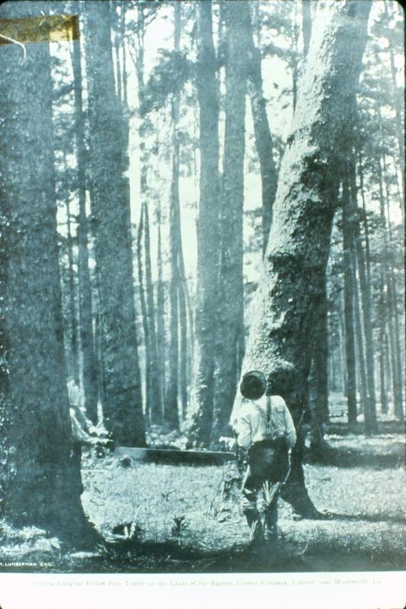

Slide 20
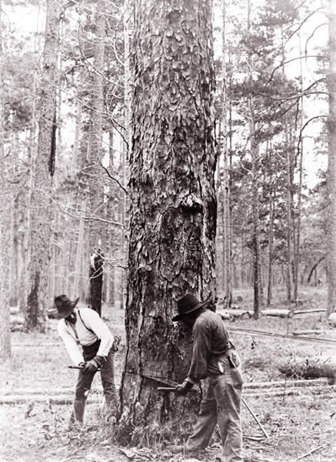
CHOCTAW INDIAN

Slide 21
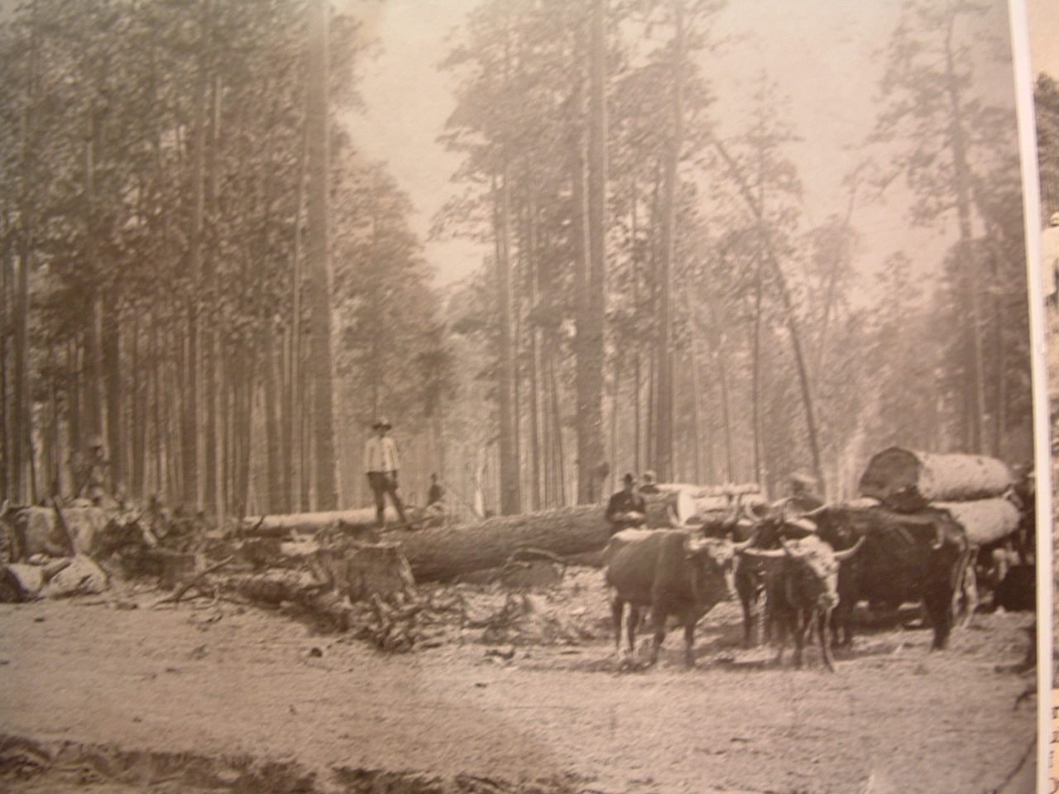
Photo on exhibit at Old Varnado Store Museum, Franklinton, LA

Slide 22
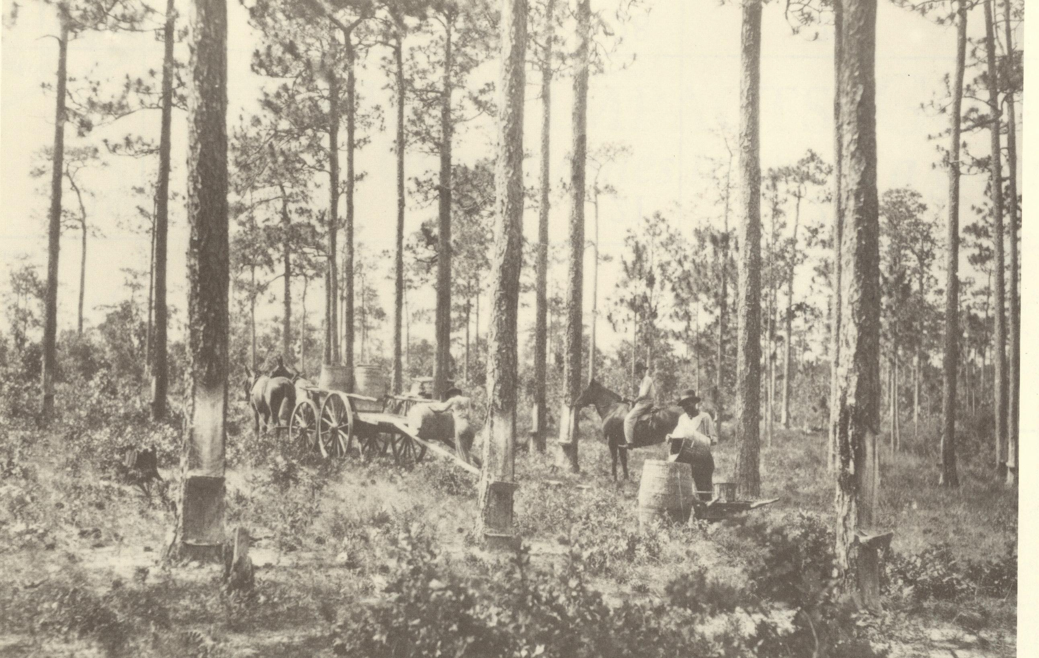

Slide 23
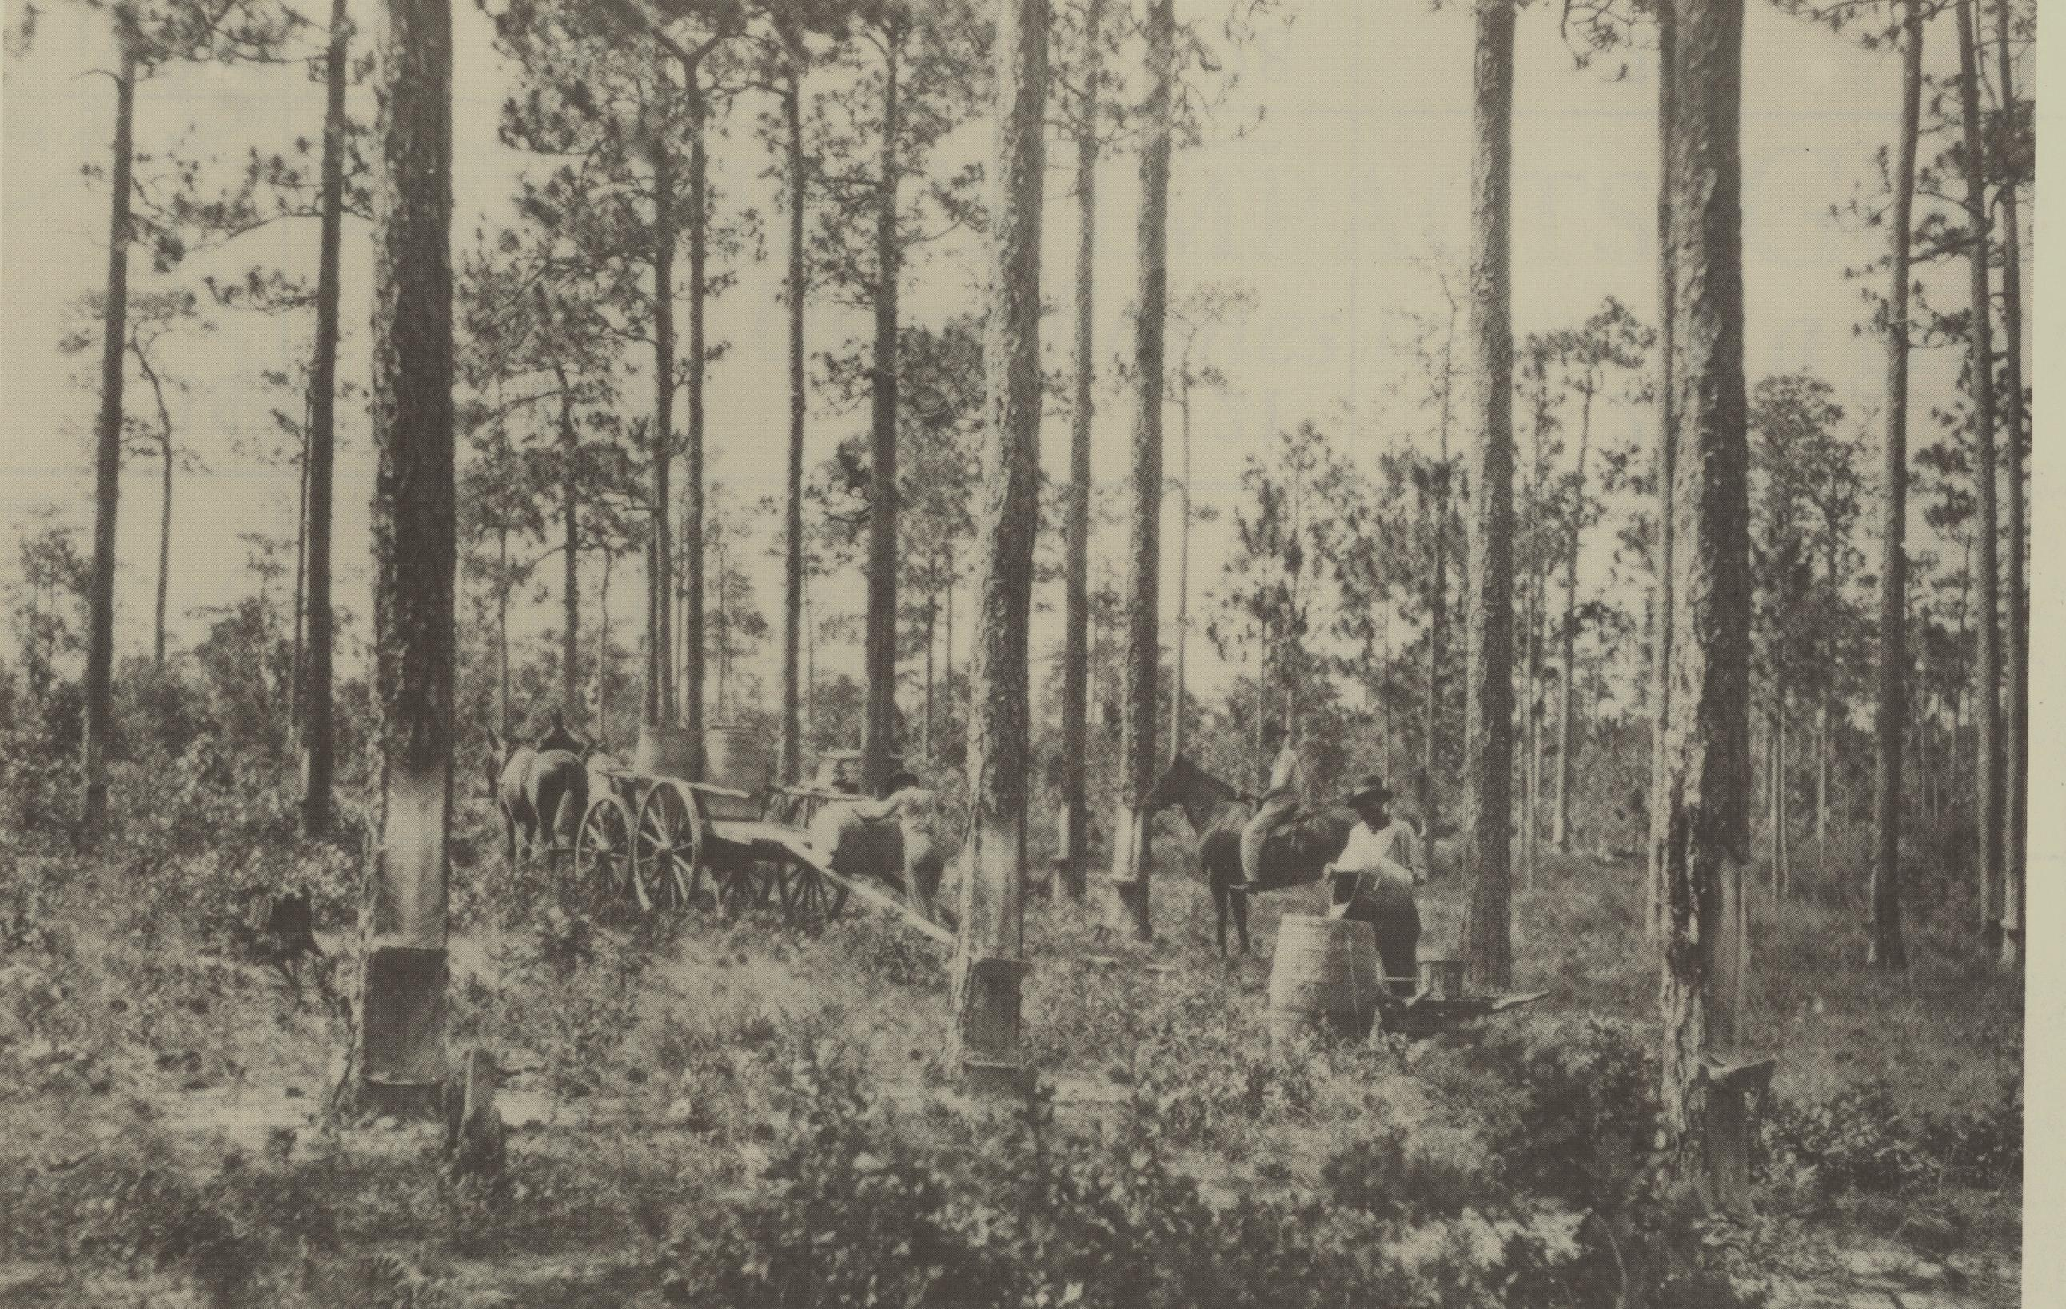
“Turpentining”
Mainly for “Naval Stores”
One of earliest commercial ventures in the Piney Woods
Became a major industry in advance of cutting of the virgin forest in the late 1800’s
Still find remains of old turpentine cups

Slide 25
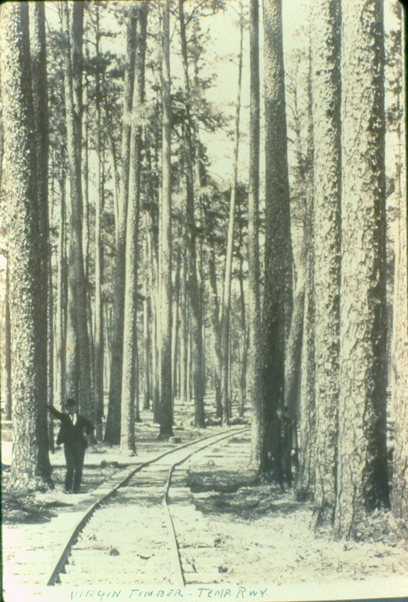
Beginning Circa 1880
Railroads in the Piney Woods

Slide 26
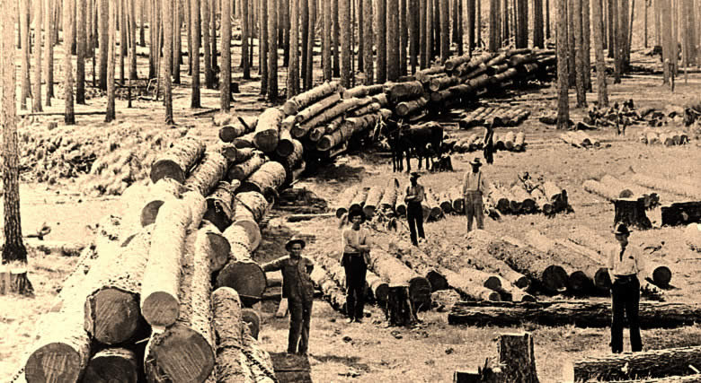
CHOCTAW INDIAN

Slide 27
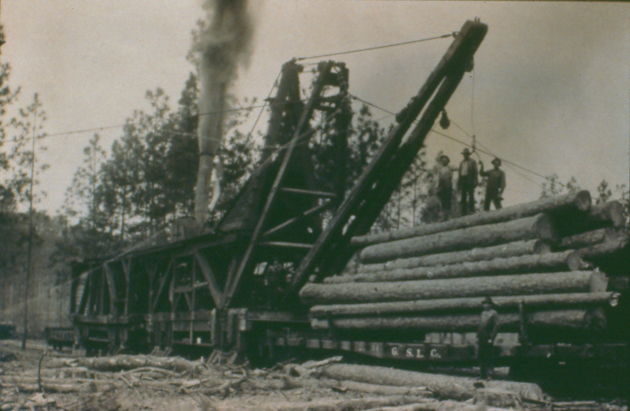
Steam Skidder – Came along ca. 1900
Load upwards of 500 logs per day

Slide 28
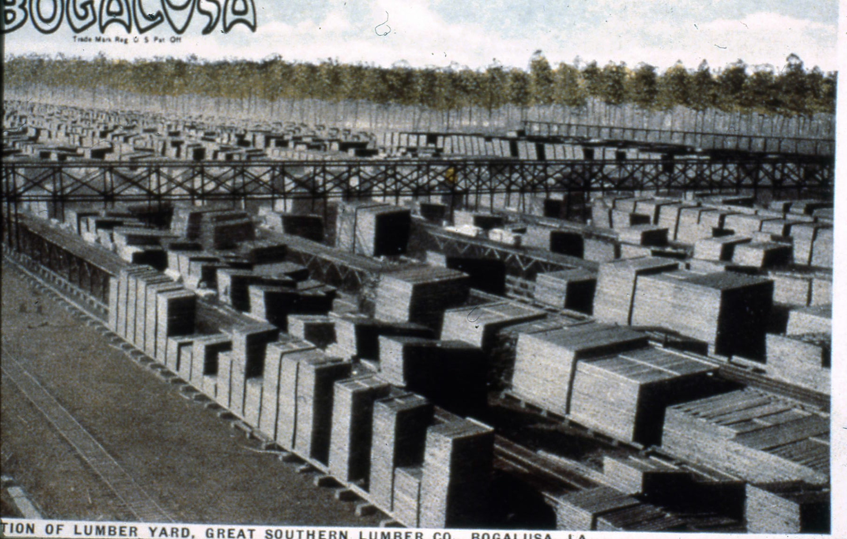
The Great Southern Lumber Company, Bogalusa
Could mill One Million BF of Lumber Every Day at its peak

Slide 29
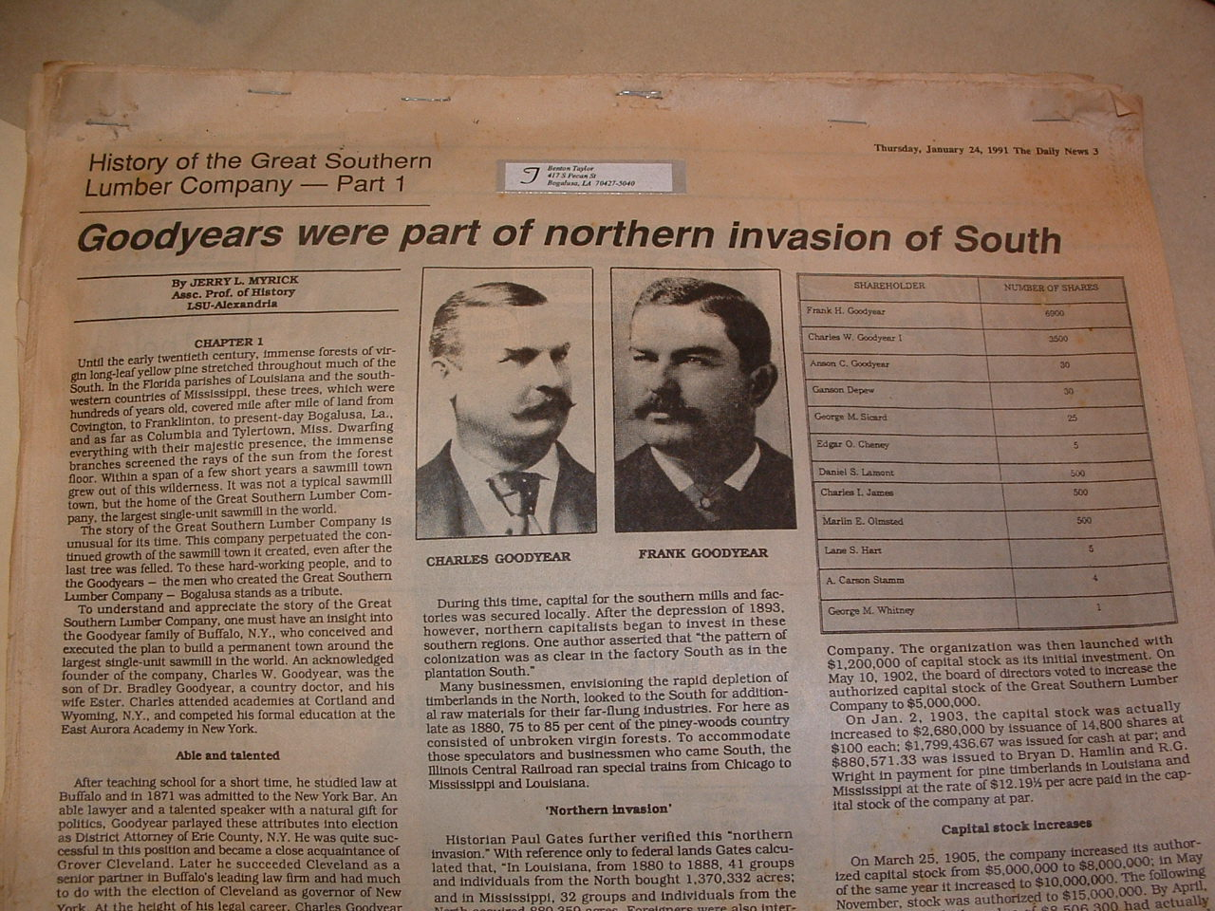
Goodyears were one of a number of wealthy northern timber interests that came south with the depletion of the White Pine forests in the Great Lakes area
Paper on exhibit at Old Varnado Store Museum, Franklinton, LA

Slide 30
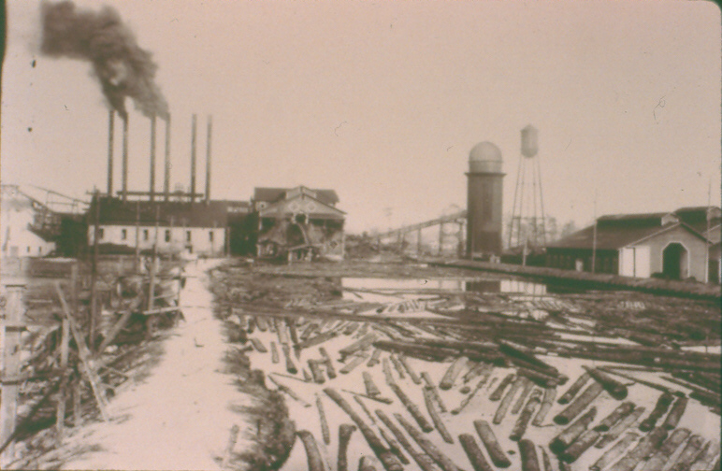
SLU Collection
Natalbany (Denkman) Lumber Co.

Slide 31
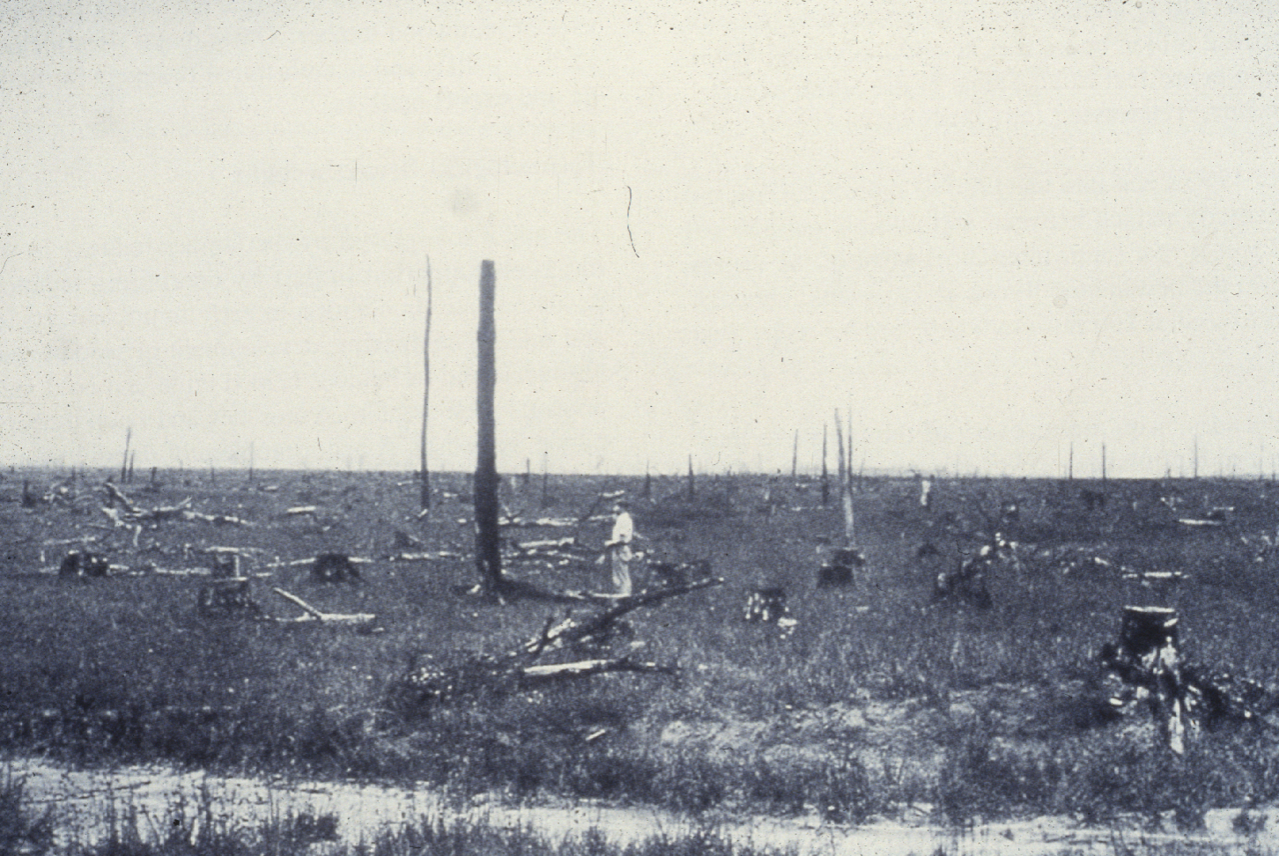
Typical Scene About 1930
End of the “Cut Out & Get Out”

Slide 32
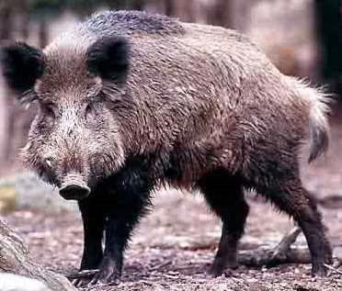
PINEY WOODS ROOTER
One hog could root hundreds of saplings a day for sweet inner bark of roots

Slide 33
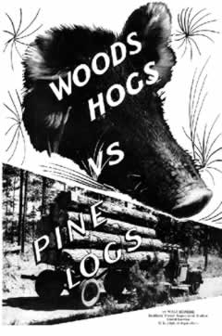

Slide 34

Smokey Bear campaign began in the early 1900’s
Led by well-intentioned but misinformed agencies
Put a stop to lots of woods burning
Helped create a mindset in the public that all fire is bad
Led to fire suppression over vast areas and encroachment by off-site trees and shrubs

Slide 35
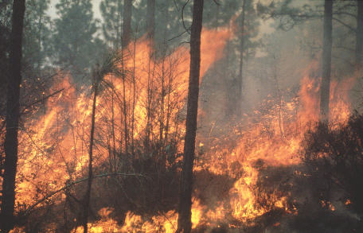
BORN OF FIRE…..

Slide 36
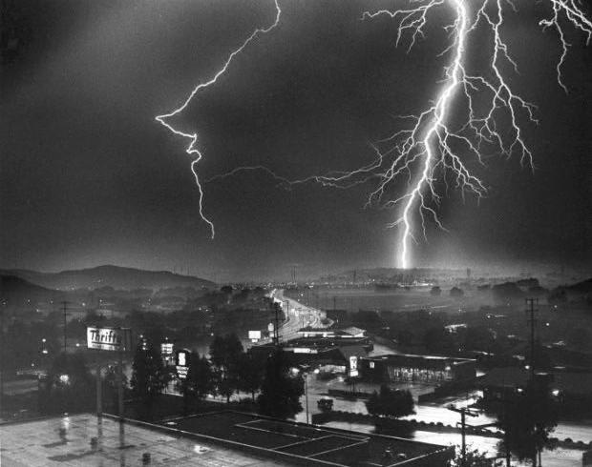
Lightning slide
Many Believe most Fire Originated from Lightning

Slide 37
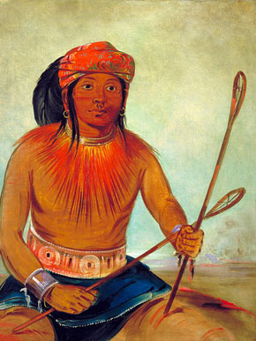
CHOCTAW INDIAN
Native Americans burned the land for numerous reasons
The Native American of the eastern Florida Parishes at the time of the early settlers

Slide 38
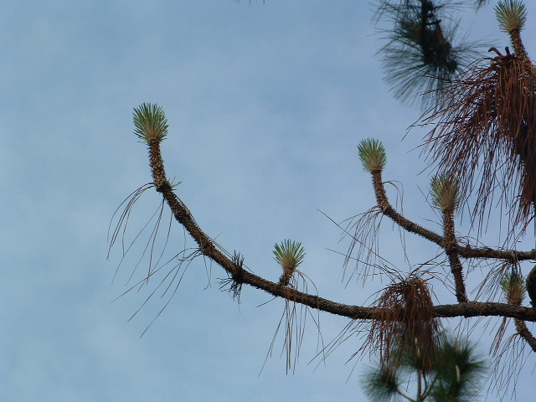
Arguably Most Fire-Adapted Tree in North America
Longleaf resprouts after fire
Other Adaptations
*Thick Bark
*Grass Stage Resistant to fire
*High Resin Content of needles Encourages Fire

Slide 39
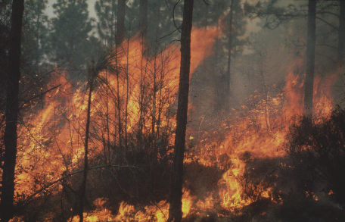
* Kills invading shrubs and trees
* Stimulates flowering/seeding by many plants
* Stimulates growth of young longleaf
* Removes smothering duff layer and favors high native plant diversity
* Creates open pineland conditions favored by many wildlife species
Many other effects

Slide 40
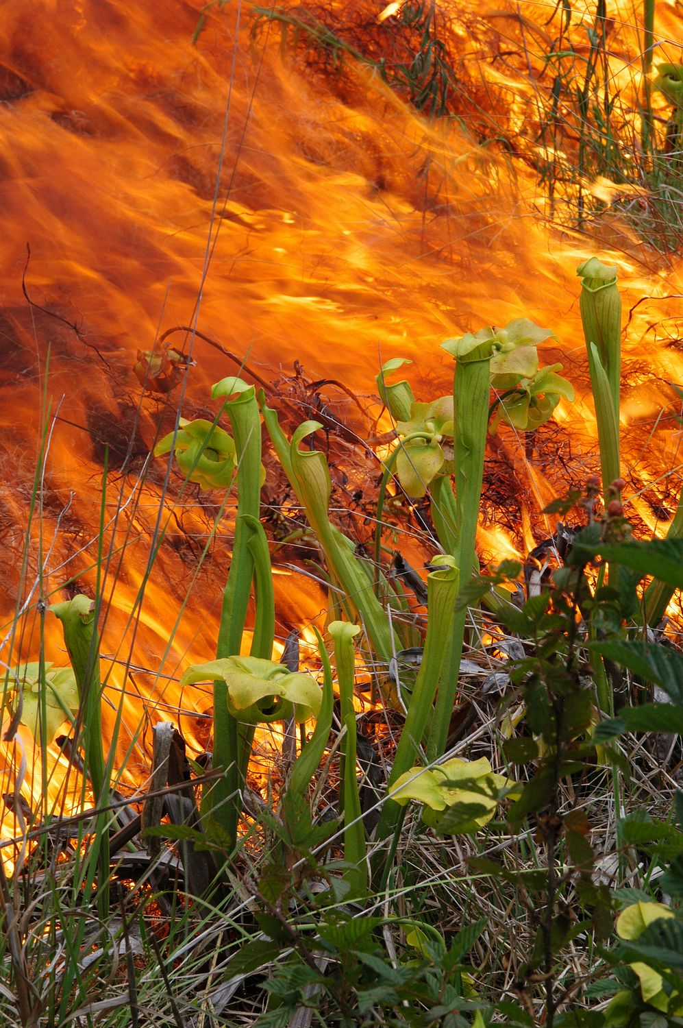
Picture by Bill Rivers

Slide 41
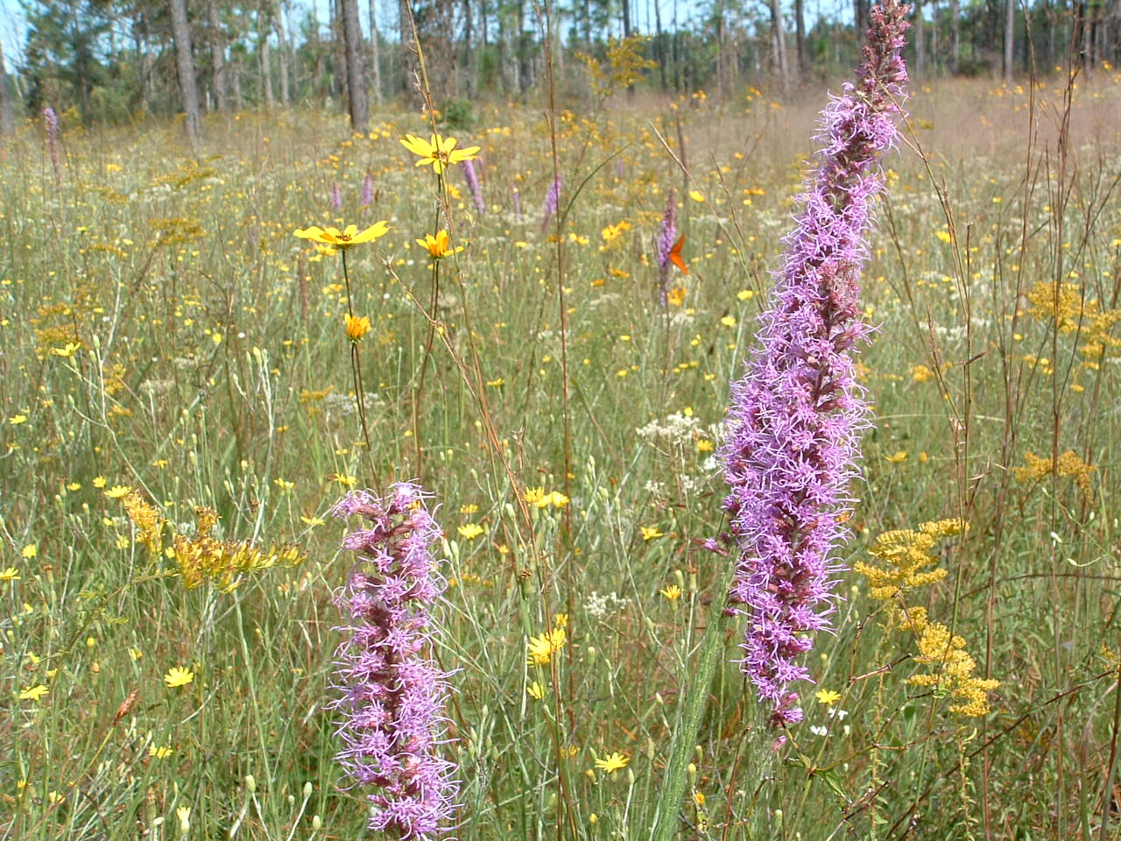
Diverse native ground cover depends on frequent fire
“Like a Prairie Under the Pines”

Slide 42
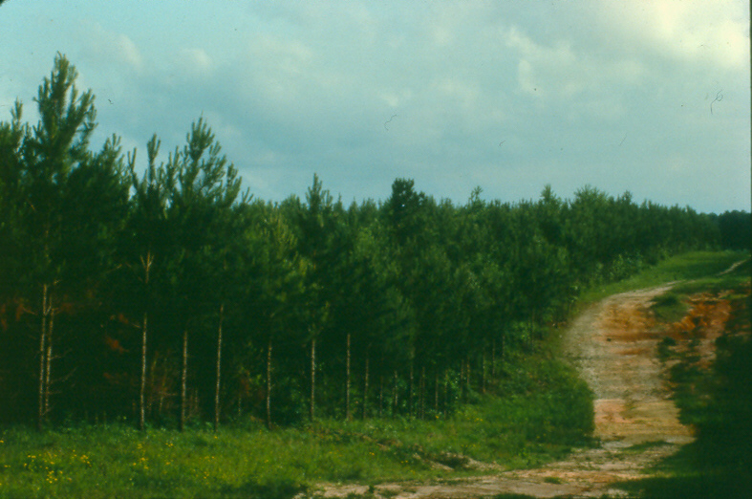
Plantation Forestry with Loblolly and Slash Pine
Began slowly in the 1930’s
Really got going about 1950
Had “bad luck” planting longleaf
Estimate ~ 200,000+ acres planted to lob and slash in longleaf range of southeast LA

Slide 43
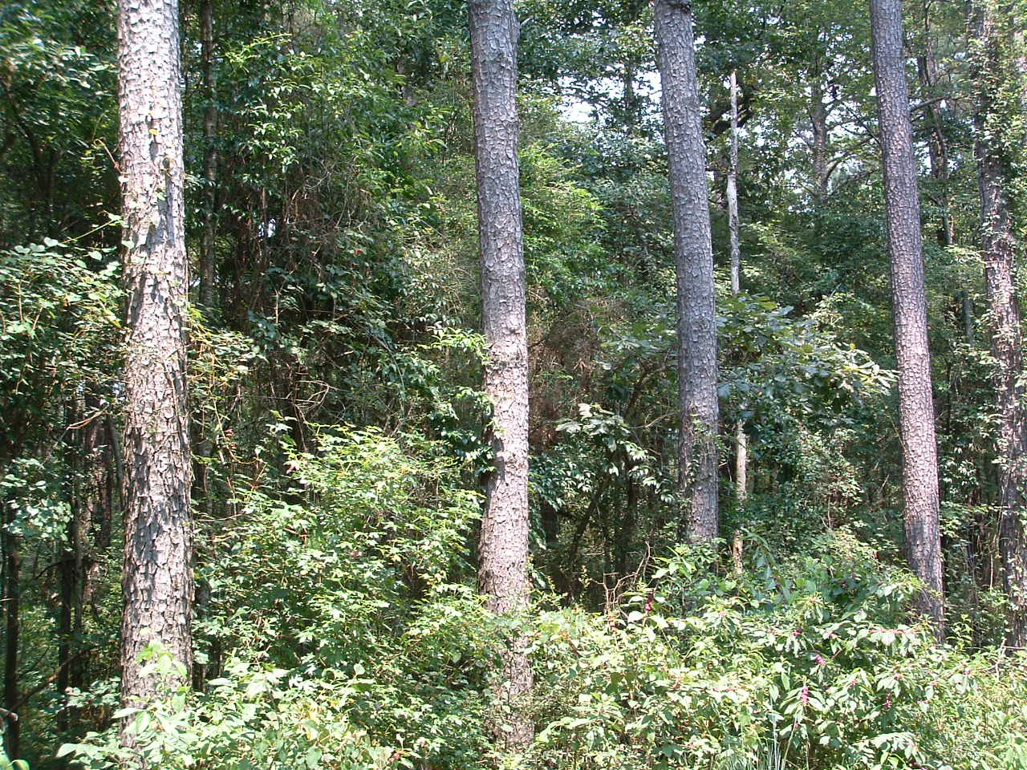
Overgrown Former Longleaf

Slide 44
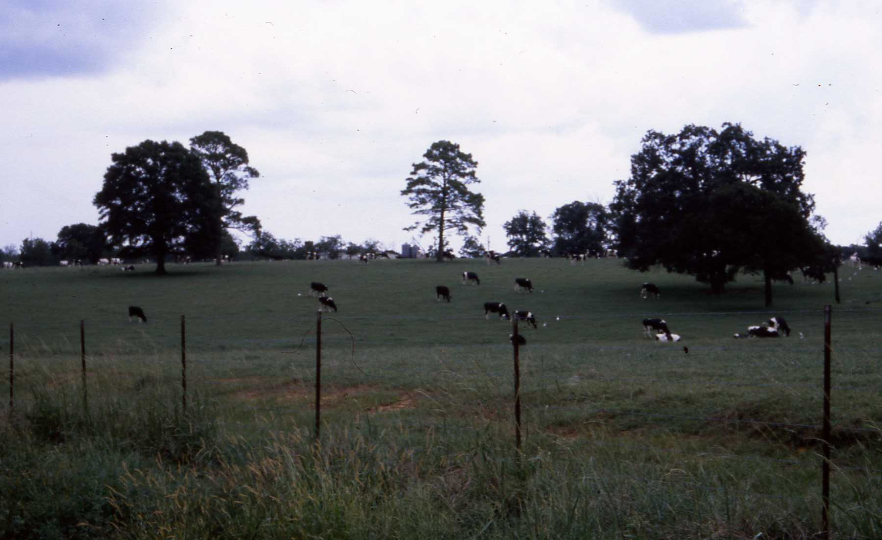
Dairy Farm Industry

Slide 45
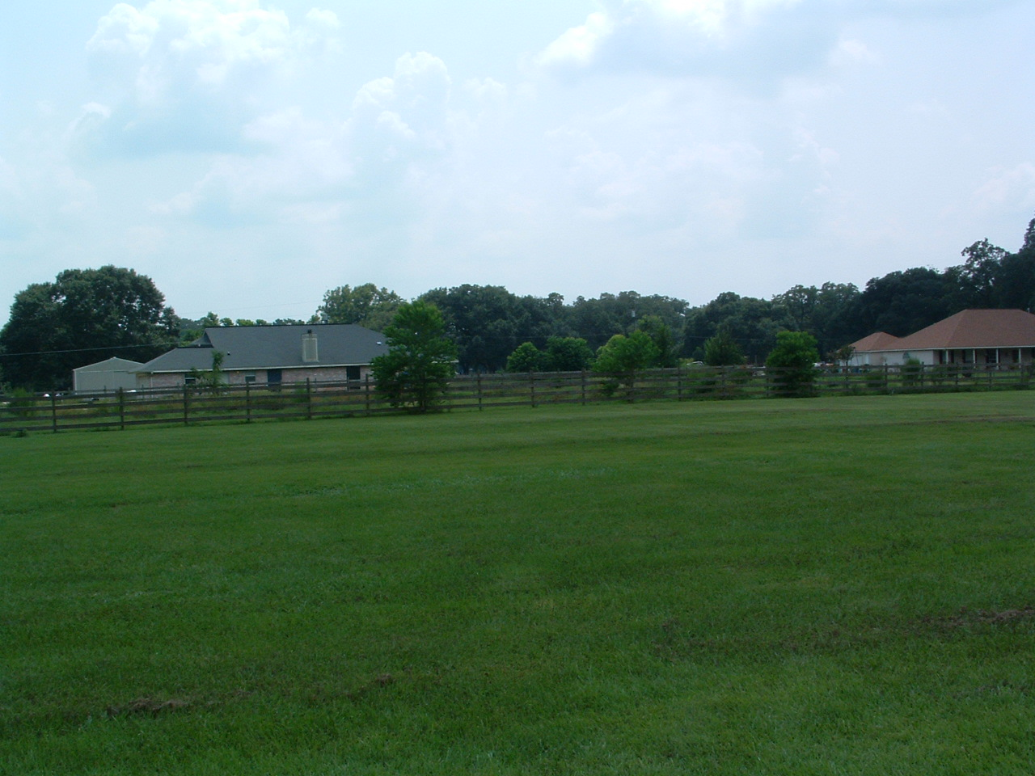
Residential and Commercial Development – “Urban Sprawl”

Slide 46
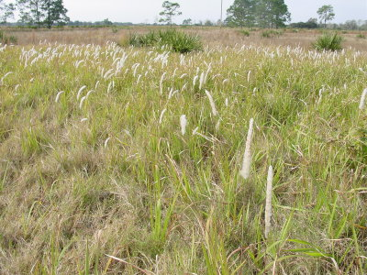
Cogon Grass
One of the greatest threats to longleaf pine habitat conservaiton

Slide 47
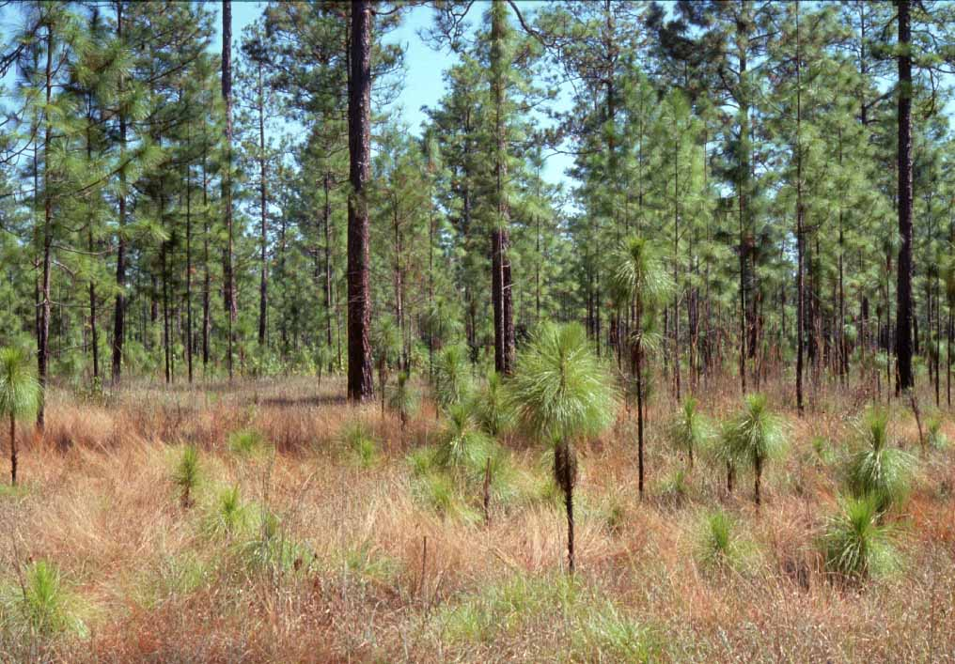
SOME REMNANT HIGH-QUALITY AREAS
Notes:
Louisiana Pacific lands at Timnber Lake Site adjacent to TNC tract. Cooperative management agreement between TNC and LP will lead to continued management for the upland longleaf community, including frequent burning and maintenance of a longleaf-dominated, uneven-aged overstory.

Slide 48
Kentwood
Clinton
Franklinton
Greensburg
Bogalusa
Amite
Pride
Folsom
Hammond
Covington
Only ~ 20,000 - 30,000 Acres
Of Natural Stands Remain

Slide 49
THE END….
OR HOPEFULLY ON TO A
NEW BEGINNING

Slide 50
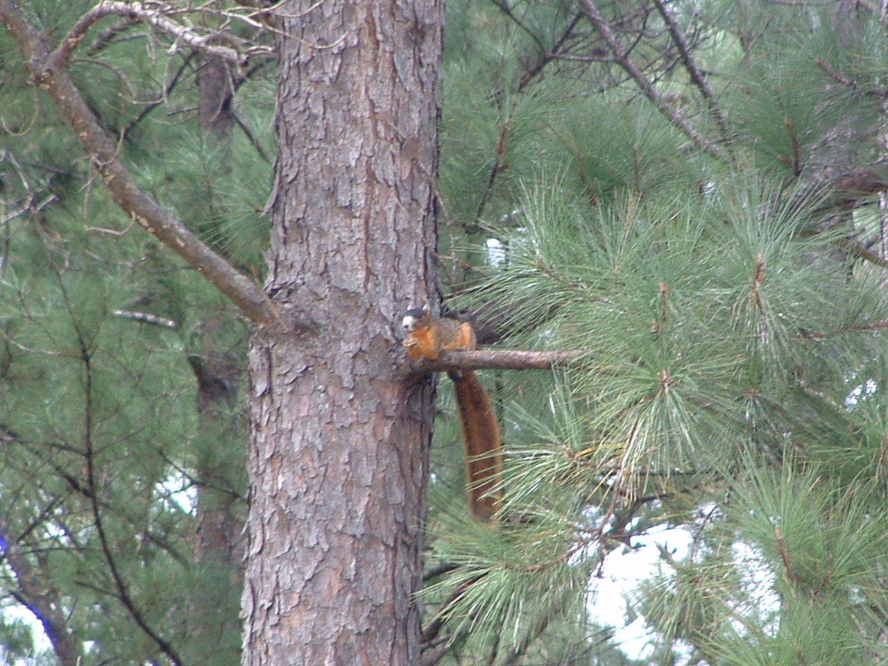
Bachman’s Fox Squirrel

Slide 51
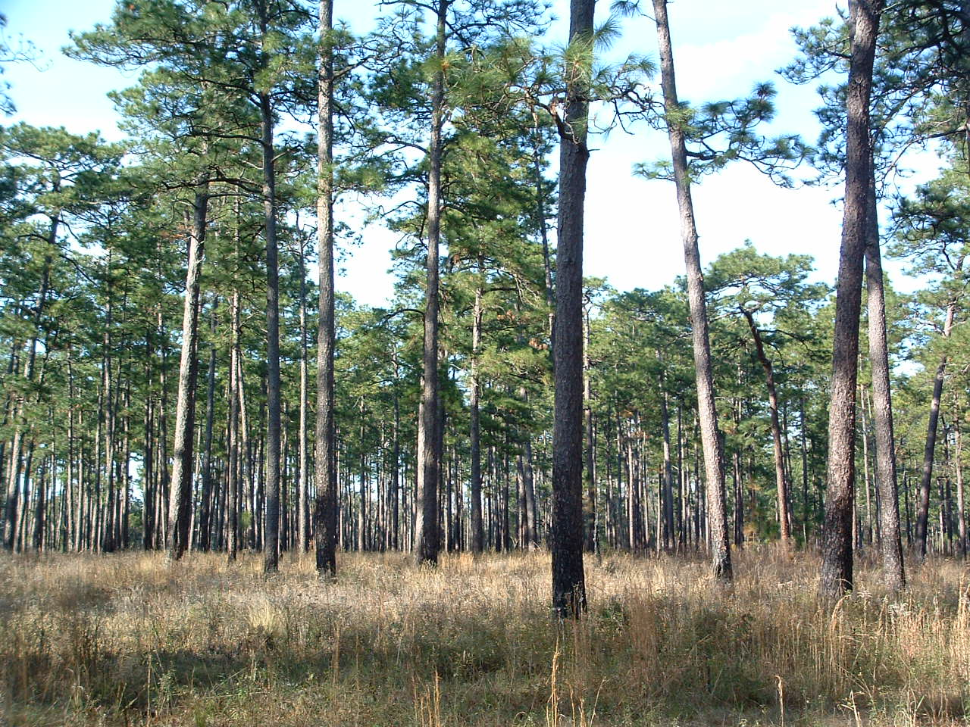
CHOCTAW INDIAN
Upland Woodland

Slide 52
Prevailing Current Conditions
Overgrown, fire suppressed, many exotics
Pine Plantations
Dairy & agricultural fields
Subdivisions/residential/commercial
Highways, roads, powerlines, miscellaneous
Only about 1 - 2 % of original longleaf pine habitat remains in relatively natural condition

Slide 53
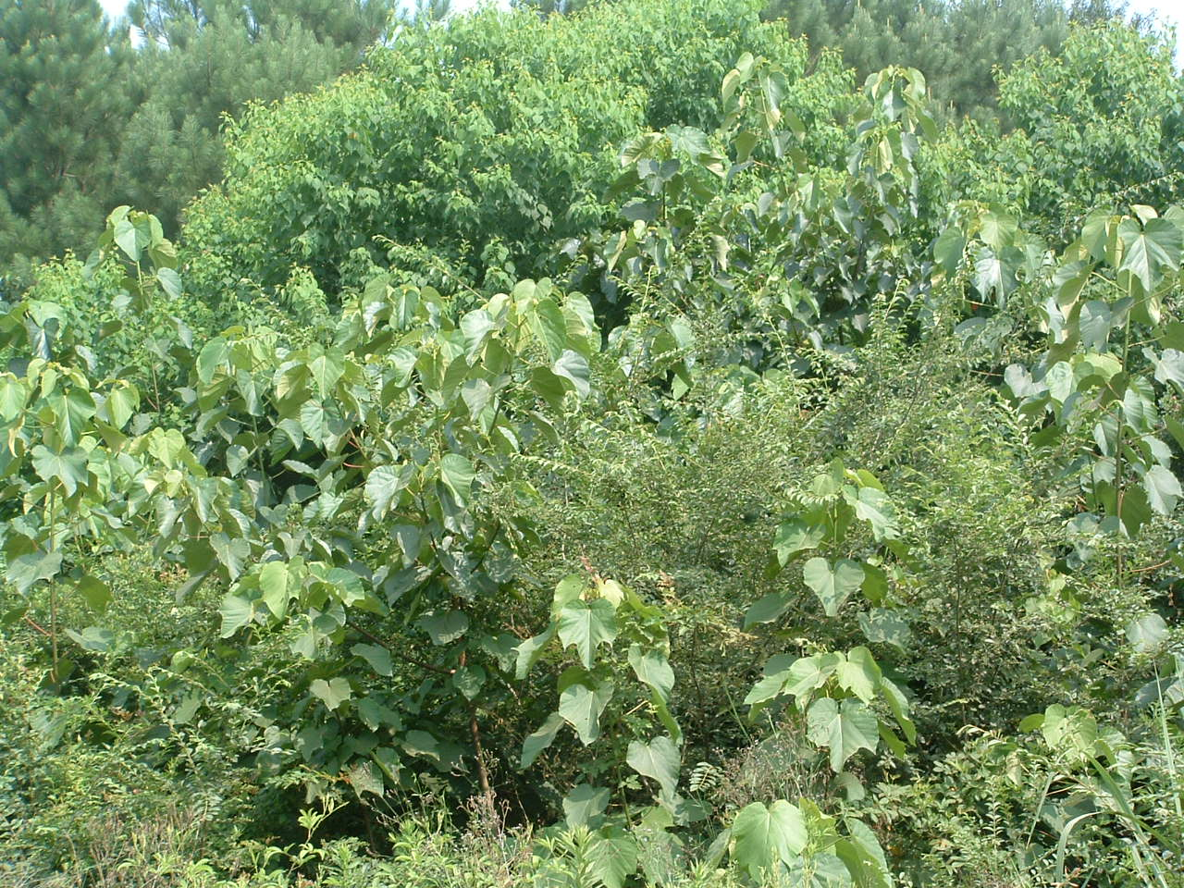
Tallow Tree
Privet Hedge
Tung Oil

Slide 54
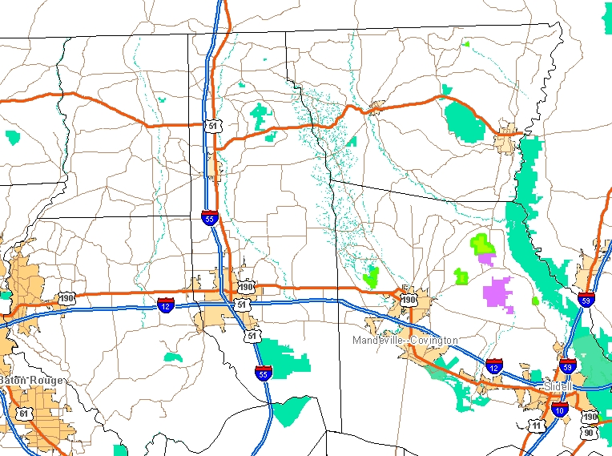
IMPORTANT LONGLEAF PINE PROTECTED AREAS
Sandy Hollow WMA
LSU Camp
O
Girl Scout Camp
Hammond
Lake Ramsay
Abita
Big Branch Rfg.

Slide 55
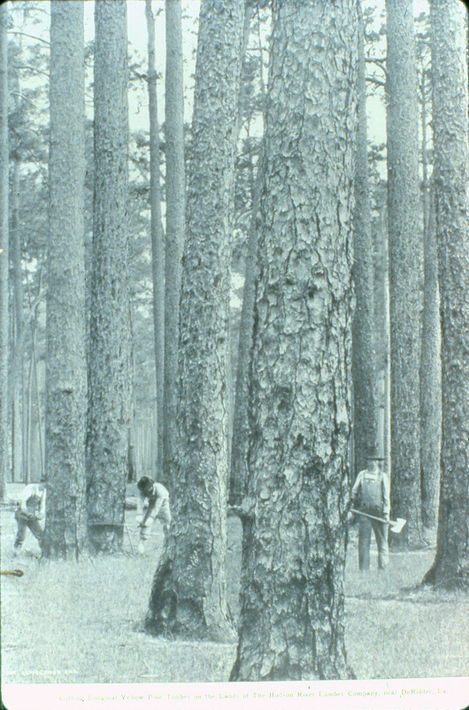

Slide 56
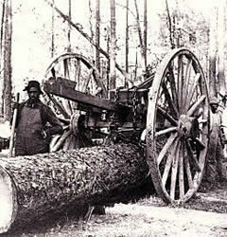
CHOCTAW INDIAN

Slide 57
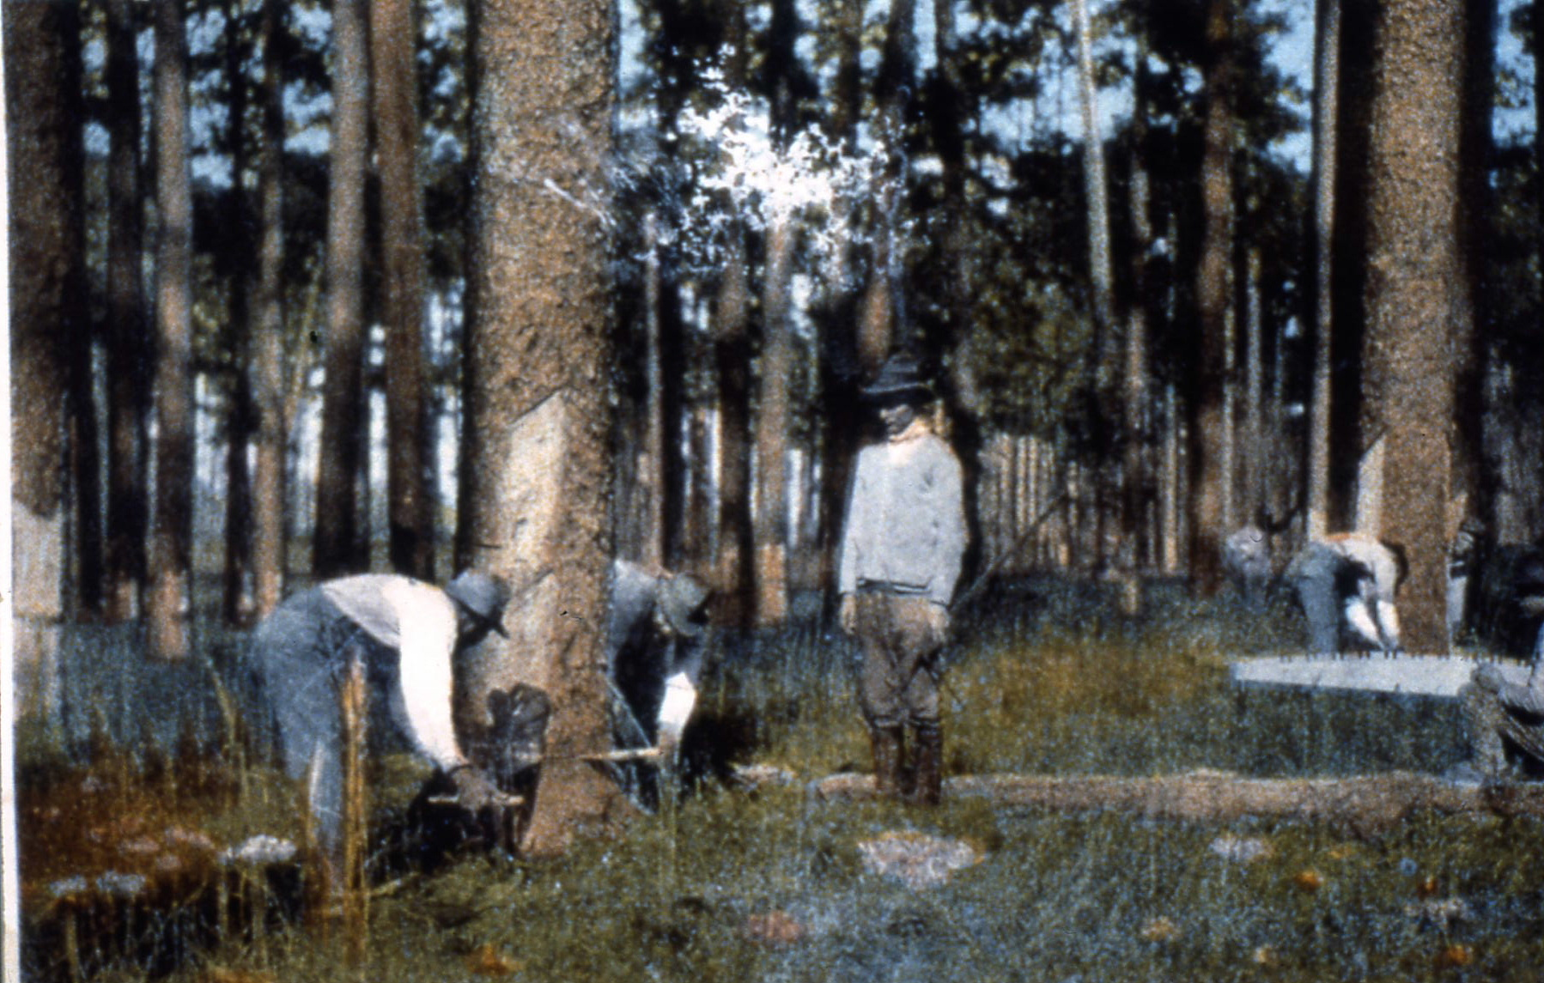

Slide 58
Early Logging of Longleaf Pine in Louisiana
* Began slowly in the late 1700’s
* Early logging restricted to areas near streams
* Logs taken by oxen and wagons to nearby mills, or rafted along streams to mills downstream

Slide 59

Photo on exhibit at Old Varnado Store Museum, Franklinton, LA

Slide 60

Photo on exhibit at Old Varnado Store Museum, Franklinton, LA

Slide 61

CHOCTAW INDIAN

Slide 62


Slide 63

CHOCTAW INDIAN

Slide 64


Slide 65
CHOCTAW INDIAN
Into these Forests ….

Slide 66


Slide 67

Early transport to streams by oxen & mules

