Slide 1
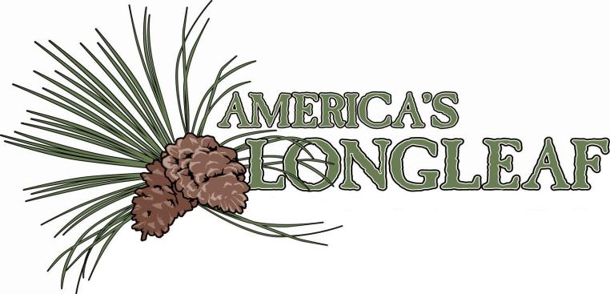

Slide 2
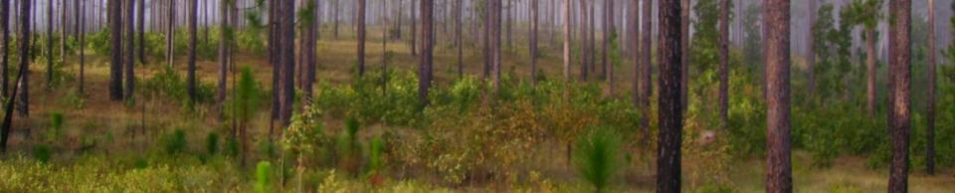
BRIEF HISTORY OF LONGLEAF PINE
Rise and fall of LLP
Forest Management for Longleaf an Overview
Local/State/Federal Efforts to Reforest Longleaf

Slide 3
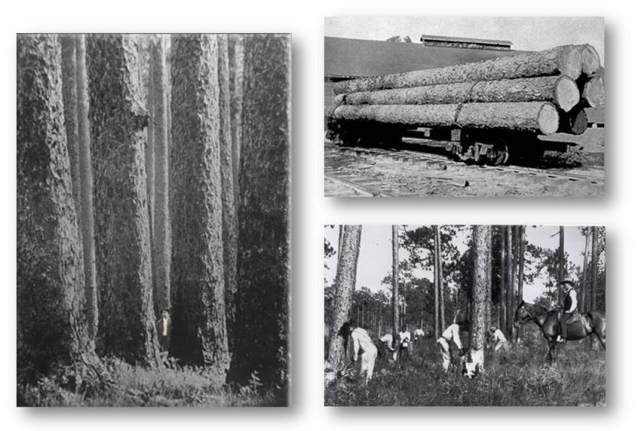
“a continuous, measureless forest, an ocean of trees”
-J. D. Schoepf (1780)

Slide 4
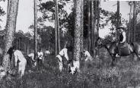
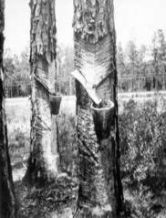

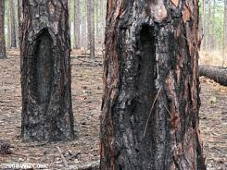
History of Longleaf Pine in the Colonies
At time of settlement (1600s), there were as much as 93 million acres of longleaf pine-dominated forests in The United States.
Naval stores industry began when John Smith exported the first “tryalls of Pitch and Tarre”. Pitch was used for sealing boat hulls; tar was the grease for wagon axles.
Both tar kilns and boxing of live trees were used to produce/collect pine tar and crude gum.

Slide 5
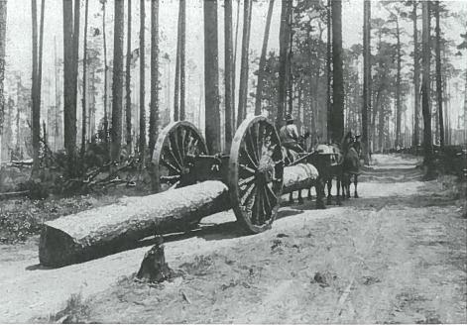
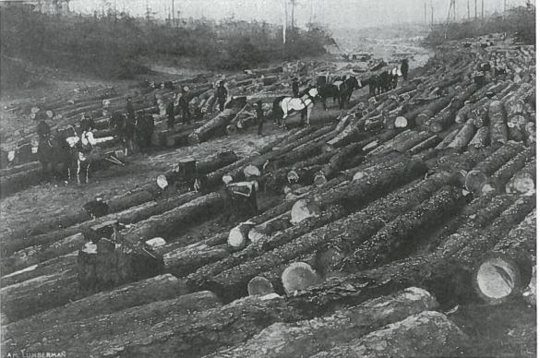
Reasons for Early Stand Conversion
Longleaf was seen to have slow growth compared to other southern pines, so foresters recommended conversion.
Fire suppression was seen as a major mission of the Forest Service which provided a competitive advantage to loblolly and slash.
The housing boom after WWII with a large need for “yellow pine” for homes, loblolly and slash pine were preferentially chosen for reforestation.

Slide 6
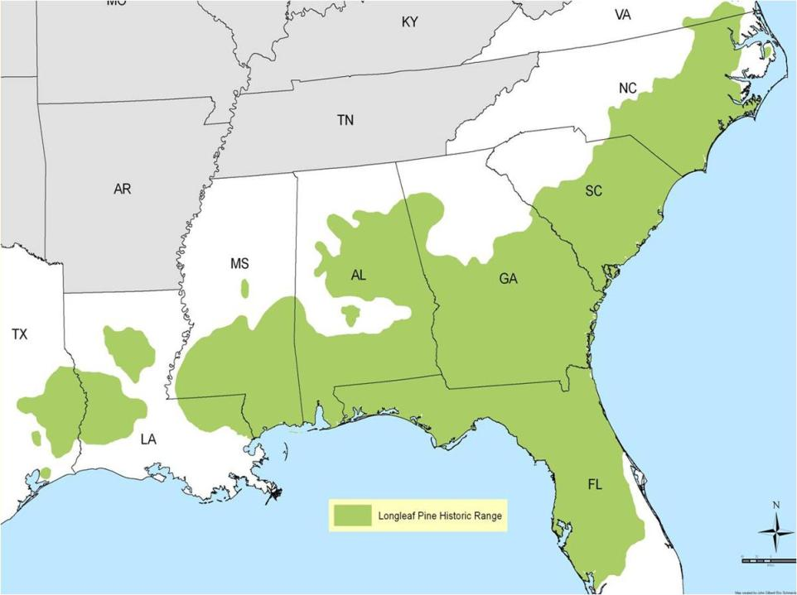
Historic Range of
Longleaf Pine Ecosystem

Slide 7
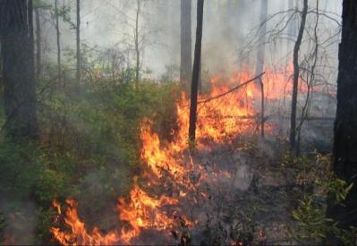
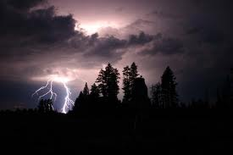
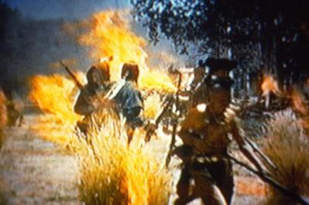
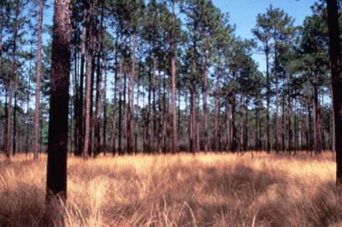
Longleaf: “The Forest that Fire Made”

Slide 8
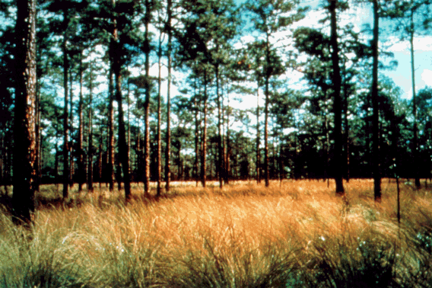
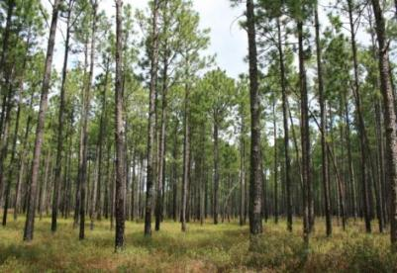
Longleaf – Wiregrass Savannas/Flatwoods of the Atlantic and Gulf Coast
Longleaf – Bluestem Flatwoods of Southeast Virginia

Slide 9
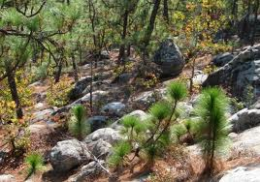
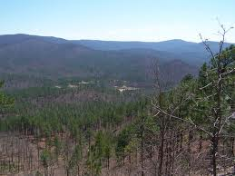
Montane longleaf pine woodlands of Northeast Alabama and Northwest Georgia

Slide 10
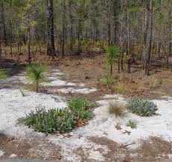
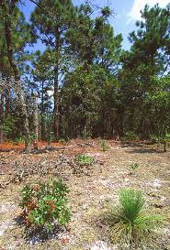
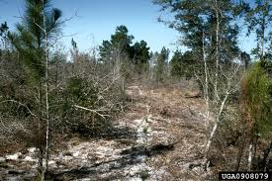
Longleaf pine Sandhills of Virginia through Georgia

Slide 11
Source: U.S. Forest Service

Slide 12
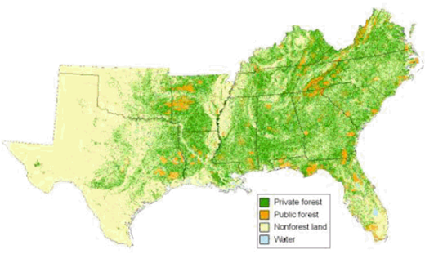
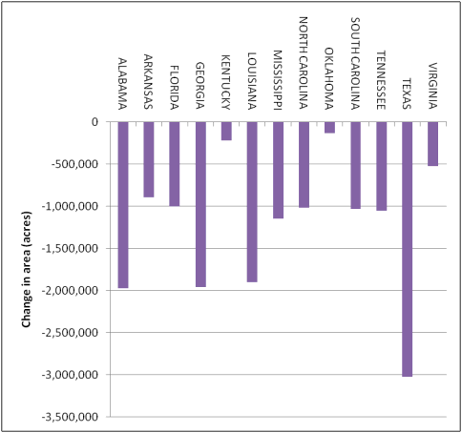
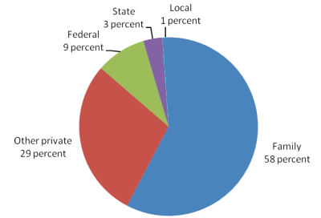
Forest Landowner Trends
Source: U.S. Forest Service

Slide 13

QUESTIONS
Why are you interested in learning more about longleaf pine e.g. family history, prescribed fire, NRCS cost share?
Longleaf Forests offer viable resources to forest landowners– What are some of the concerns you had in planting longleaf on your lands or client properties?
Longleaf forests can provide multiple benefits- economic, ecological, and social. What values do you think are most important to you?

Slide 14
Forest Management Considerations and Concerns
Misconceptions of Longleaf Pine
Forest Products
Working Lands Values

Slide 15
Misconceptions of Longleaf Pine
Slow growth compared to loblolly – Because longleaf stays in grass stage for up to five years it is perceived to be slow growing, but at 30 years it has comparable growth to other southern pines.
Only grows on poor sites – With most longleaf only surviving in areas were slash and loblolly are not competitive, current landowners don’t believe it will do well on high site index sites.
Longleaf are not as economical as other southern pines – With most southern pines pole timber is estimated to be 20-25% of well managed stands, longleaf stands typically provide 70-80% of poles at harvest.

Slide 16
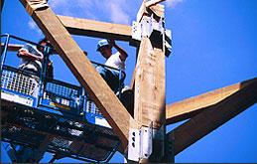
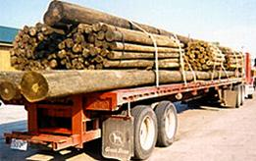
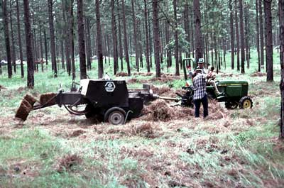
Longleaf Pine Values: Forest Products

Slide 17
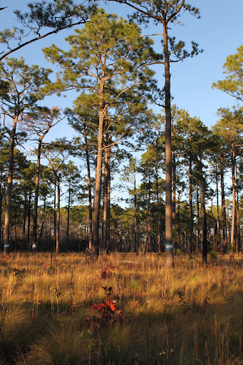
Forest Health
Longleaf are less susceptible to pests like the southern pine beetle and are more fire tolerant, which has proven to lower certain forest pests as well
Longleaf in natural stands is more tolerant to wind throw from various natural disasters
Longleaf lives for longer than other southern pines providing long-term habitat for game species and stronger wood for timber sales

Slide 18
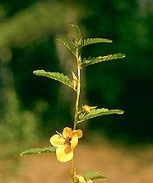
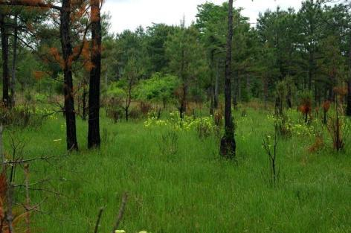
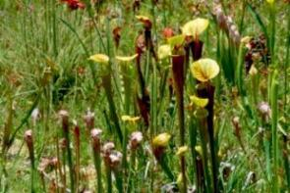
Longleaf Pine Values: Aesthetics

Slide 19
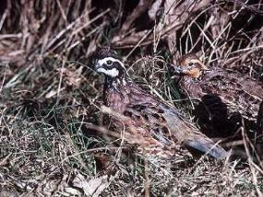
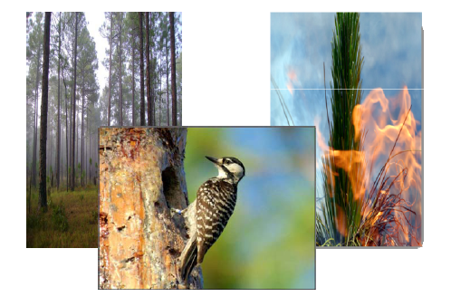
Longleaf Pine Values: Wildlife Habitat

Slide 20
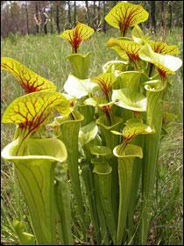
Wildlife Values of Longleaf Pine
The longleaf pine–grassland forest may well be
the most diverse North American ecosystem north
of the tropics, containing rare plants and animals
not found anywhere else
The understory contains from 150 to
300 species of groundcover per acre
36 mammals, 170 reptiles and amphibians
100 birds, insects, and around 900 plants
  ~ 30 federally listed species

Slide 21

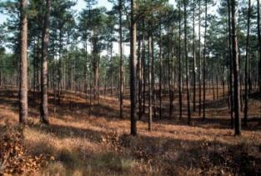
Distinct and Diverse Forest Type
Species diversity is distributed across 12 longleaf pine ecological systems (NatureServe)
Hydrologically ranging from sandhills to mesic wet savannas
Geographically ranging from the Atlantic Coastal Plain to the West Gulf Coastal Plain

Slide 22
QUESTIONS
What benefits are you looking for in longleaf pine management?
How will longleaf management change the way you manage your property or client lands?
What are some concerns new concerns you might have to longleaf management?

Slide 23
America’s Longleaf a Restoration Initiative
Conservation Plan
Plan Highlights
Local Implementation Teams
Notes:
http://www.americaslongleaf.org

Slide 24

Conservation Plan
America’s Longleaf Initiative established
Draft a Range-wide LLP Conservation Plan
Intensive Charrette, over 120 professionals
Released March 2009
80+ Key actions identified in the plan
Notes:
http://www.americaslongleaf.org/resources/conservation-plan/

Slide 25
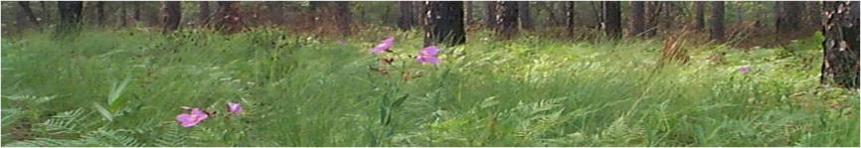
LLP Conservation Plan
Provides a “road map” to conserve longleaf range-wide
Establishes goal to move from 3.4 million existing acres to 8 million acres in 15 years (80% of increase on private lands)
Establishes 6 overarching strategies to achieve the goals from local to national levels

Slide 26

Six Overarching Strategies
1. Public Lands
2. Private Lands
3. Economic and Market-based
4. Fire Management
5. Understory and Overstory
6. Climate Change

Slide 27
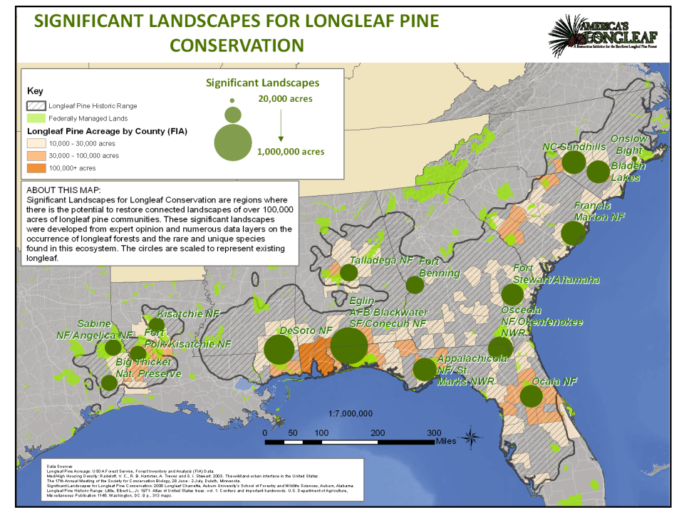

Slide 28
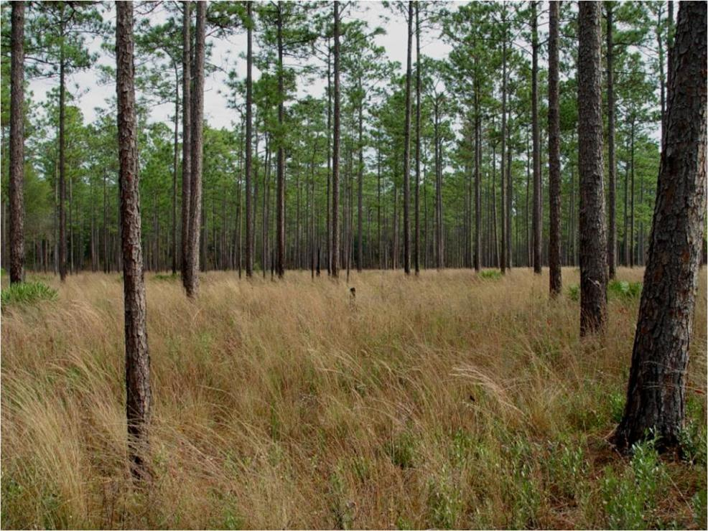
Local Implementation Teams
Key Actions…
Initiate actions to stand-up local teams within Significant Geographic Areas to further area-specific planning and on-the-ground actions.

Slide 29

Significant Landscapes and State/Local Teams Under America’s Longleaf Restoration Initiative
State Teams
Local Teams
Notes:
Most up to date map: http://www.americaslongleaf.org/implementation/implementation-teams/
State and local teams have or are forming to be the frontline in delivering programs.
State and local implementation teams help bring coordinated efforts to the ground. This is where the rubber meets the road. Everything from bringing the multiple partners to the table to coordinate their individual efforts in their area, define needed actions, find resources, and accomplish work on the ground. Efforts range from providing technical and financial assistance to landowners, education and outreach, tree or understory restoration, prescribed burning and monitoring accomplishments.
Efforts are directed to targeted landscapes to bring public and private efforts together in a coordinated fashion.
They are made up of federal/state government agencies and private organizations and are operating where we have stars on the map.

Slide 30
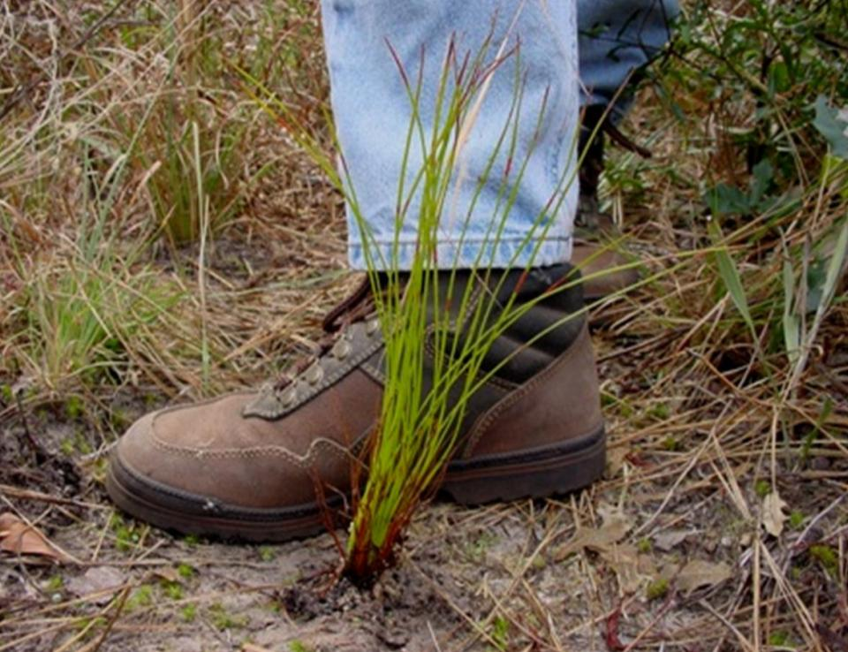
Local Team Functions
Convene
Characterize/Assess/Map/Prioritize
Set State-Level Goals
Propose High Priority Strategies/Timeline
Implement Strategies/Objectives
Secure Resources
Measure Progress

Slide 31
QUESTIONS
You seem to have a lot of structure in these local teams– how do they interact or do they with NRCS state Technical Committees, Stewardship Committees, or other institutional bodies that might have overlapping conservation priorities?
How do local teams interact with one another? Do they have similar organizational structures or focus areas?
How do local efforts contribute to the overall effort? Who determines what those efforts are?
What regional structure serves to link these local efforts?
How do local teams find support for their identified priority work?

Slide 32
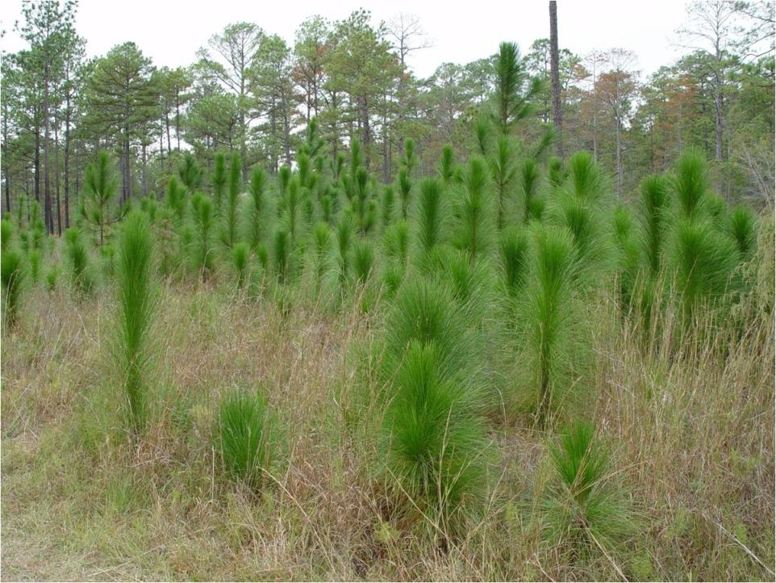
The beginning…

