Slide 1
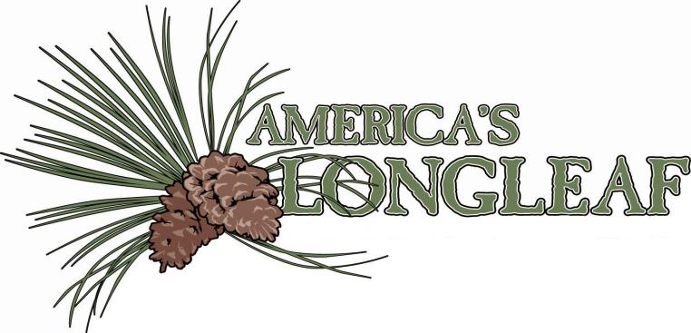

Slide 2
LONGLEAF PINE ECONOMICS
Does Longleaf Pine Make Financial Sense?

Slide 3
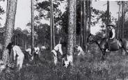
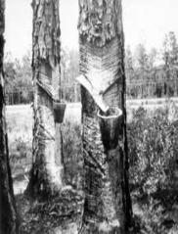
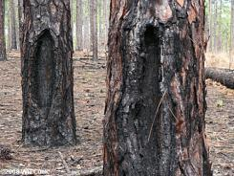
Investment Potential for Longleaf Pine
Lumbermen have long realized the value of longleaf products like high quality, straight grained dimensional lumber and strong durable poles.
Longleaf was regarded as a poor investment for years, however.
What kind of investment is longleaf pine in today’s market?

Slide 4
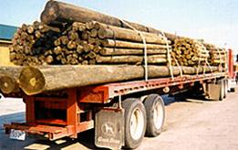
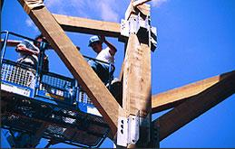
Misconceptions on Investment Potential
Longleaf has historically been considered a difficult species to plant.
Longleaf had a reputation for slow growth.
Recent developments in nursery techniques, management practices, and markets have made these prognoses dated.

Slide 5
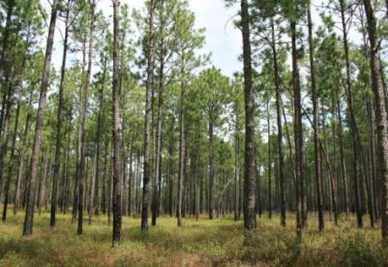
Risk Reduced
Better quality seedlings have taken out much of the risk for planting longleaf pine.
Much has been learned about the handling and planting of seedlings in the past several years as well.
These gains, coupled with increased knowledge about the role of competing vegetation and the development of selective herbicides to control it, have made is possible to shorten and in many cases eliminate the grass stage.

Slide 6
Risk Reduced
We have learned that longleaf is not a slow grower, only a slow starter.
Once established on average or poor sites, longleaf will catch and pass faster starting loblolly or slash pine in a reasonable time: 12-15 years on poor sites and 25-30 years on average sites.
On very good, productive sites, it takes longer to catch up, often outside a reasonable investment period if return on investment is the only measure used.
Growth rate of wood volume is not the only or most important measure of value of a forestry investment. A more important measure is growth rate in value or dollars, as longleaf products return a premium and grow faster in value than volume.

Slide 7
Projected Financial Return
Investment analysis (based on assumptions or projections of future performance) indicates very good growth can be expected if management is done properly and that product yields are very favorable, with a high proportion of poles and quality saw-timber produced.
Longleaf wood is heavier than other Southern pines. When wood is bought on a weight basis, more $ is paid for longleaf than for the same volume of other pines.
Longleaf pine straw has also become very valuable in the landscaping business.

Slide 8
Other Financial Considerations for Longleaf
Longleaf is resistant to diseases and insects and notably tolerant of fires, reducing risk of loss to these factors significantly.
This natural insurance policy against loss has value.
Long-term value of longleaf is maximized if trees are allowed to grow into poles, often thought to be optimal in rotations of 55 years on most sites.
Conservation Reserve Program payments make longleaf a very profitable investment over the short term as well.

